Slide 1
CS 4700
Network Fundamentals
DNS
(What’s in a Name?)
Revised 10/30/2025

Slide 2
Human Involvement
If you want to…
  Call someone, you need to ask for their phone number
    You can’t just dial “P R O F J A C K S O N”
  Mail someone, you need to get their address first
What about the Internet?
  If you need to reach Instagram, you need their IP
  Does anyone know Instagram’s IP?
Problem:
  People can’t remember IP addresses
  Need human readable names that map to IPs

Slide 3
Human Involvement
If you want to…
  Call someone, you need to ask for their phone number
    You can’t just dial “P R O F W I L S O N”
  Mail someone, you need to get their address first
What about the Internet?
  If you need to reach Instagram, you need their IP
  Does anyone know Instagram’s IP?
Problem:
  People can’t remember IP addresses
  Need human readable names that map to IPs

Slide 4
Internet Names and Addresses
Addresses, e.g., 129.10.117.100
Names, e.g. www.northeastern.edu
Computer usable labels for machines
Conform to structure of the network
Human usable labels for machines
Conform to organizational structure
How do you map from one to the other?
Domain Name System (DNS)

Slide 5
History
Before DNS, all mappings were in hosts.txt
  /etc/hosts on Linux
  C:\Windows\System32\drivers\etc\hosts on Windows
Centralized, manual system
  Changes were submitted to SRI via email
  Machines periodically FTP new copies of hosts.txt
  Administrators could pick names at their discretion
  Any name was allowed
    christos_server_at_neu_pwns_joo_lol_kthxbye

Slide 6
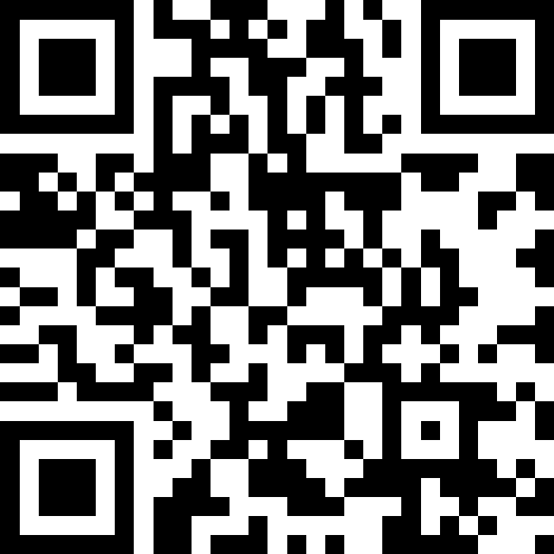
Towards DNS
Eventually, the hosts.txt system fell apart
  Not scalable, SRI couldn’t handle the load
  Hard to enforce uniqueness of names
    e.g., MIT
      Massachusetts Institute of Technology?
      Melbourne Institute of Technology?
  Many machines had inaccurate copies of hosts.txt
Thus, DNS was born

Slide 7
Towards DNS
Eventually, the hosts.txt system fell apart
  Not scalable, SRI couldn’t handle the load
  Hard to enforce uniqueness of names
    e.g., MIT
      Massachusetts Institute of Technology?
      Melbourne Institute of Technology?
  Many machines had inaccurate copies of hosts.txt
Thus, DNS was born

Slide 8
Outline
DNS Basics
Case Study: DNS and Email
DNS for Service Discovery

Slide 9
DNS at a High-Level
Domain Name System
Distributed database
  No centralization
Simple client/server architecture
  UDP port 53, increasingly shifting to TCP
Hierarchical namespace
  As opposed to original, flat namespace
  . → .com. → google.com. → mail.google.com.

Slide 10
Naming Hierarchy
Root (dot, “.”)
net
edu
com
gov
mil
org
uk
fr
network
horse
etc.
neu
mit
Top Level Domains (TLDs) are at the top
Each Domain Name is a subtree
  .edu → neu.edu → ccs.neu.edu → www.ccs.neu.edu
Maximum tree depth: 128
Name collisions are avoided
  neu.com vs. neu.edu vs. neu.org
ccs
ece
husky
www
login
mail

Slide 11
Exercise: $ dig www.ccs.neu.edu
; <<>> DiG 9.10.6 <<>> www.ccs.neu.edu
;; global options: +cmd
;; Got answer:
;; ->>HEADER<<- opcode: QUERY, status: NOERROR, id: 50636
;; flags: qr rd ra; QUERY: 1, ANSWER: 2, AUTHORITY: 0, ADDITIONAL: 1
;; OPT PSEUDOSECTION:
; EDNS: version: 0, flags:; udp: 4096
;; QUESTION SECTION:
;www.ccs.neu.edu. IN A
;; ANSWER SECTION:
www.ccs.neu.edu. 183 IN CNAME presscache.ccs.neu.edu.
presscache.ccs.neu.edu. 183 IN A 52.70.229.197
;; Query time: 58 msec
;; SERVER: 155.33.33.75#53(155.33.33.75)
;; WHEN: Tue Feb 19 11:05:55 EST 2019
;; MSG SIZE rcvd: 85
Header info from the response
The original question
Answers(s)

Slide 12
Hierarchical Administration
Verisign
Root
ICANN
net
edu
com
gov
mil
org
uk
fr
horse
etc.
Northeastern
neu
mit
Tree is divided into zones
  Each zone has an administrator
  Responsible for that part of the hierarchy
Example:
  Khoury controls *.ccs.neu.edu
  NEU controls *.neu.edu
Khoury
ccs
www
login
mail

Slide 13
Server Hierarchy: What must a DNS server do?
Functions of each DNS server:
  Authority over a portion of the hierarchy
    No need to store all DNS names
  Store all the records for hosts/domains in its zone
    May be replicated for robustness
  Know the addresses of the root servers
    Resolve queries for unknown names
Root servers know about all TLDs
  The buck stops at the root servers

Slide 14
Root Name Servers
Responsible for the Root Zone File
  Lists the TLDs and who controls them
  ~2MB in size
com. 172800 IN NS a.gtld-servers.net.
com. 172800 IN NS b.gtld-servers.net.
com. 172800 IN NS c.gtld-servers.net.
…
edu. 172800 IN NS a.edu-servers.net.
edu. 172800 IN NS b.edu-servers.net.
edu. 172800 IN NS c.edu-servers.net.
…
Administered by ICANN
  13 root servers, labeled A→M
  Practically all are anycasted, i.e. they are globally replicated. BGP finds the closest copy
Contacted when names cannot be resolved
  In practice, most systems cache this information

Slide 15
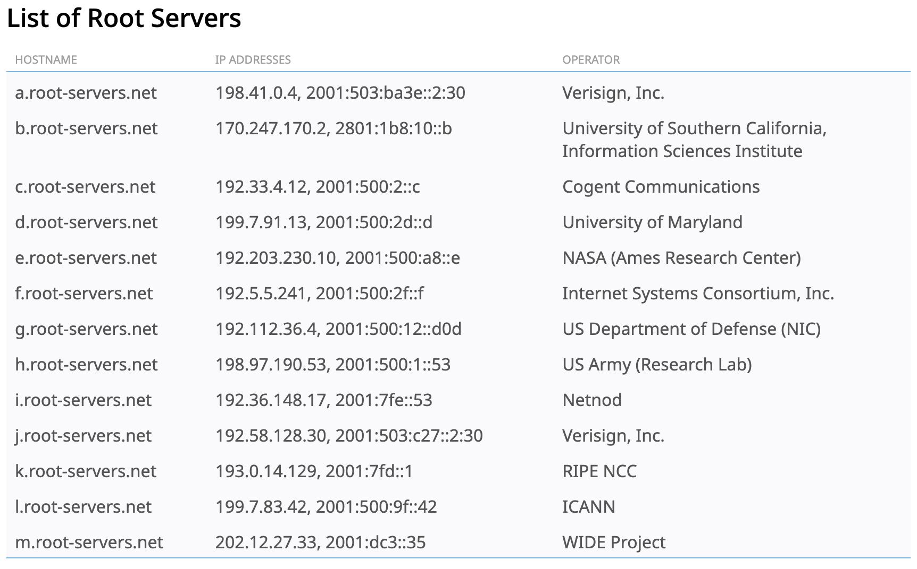
Root servers and operators

Slide 16
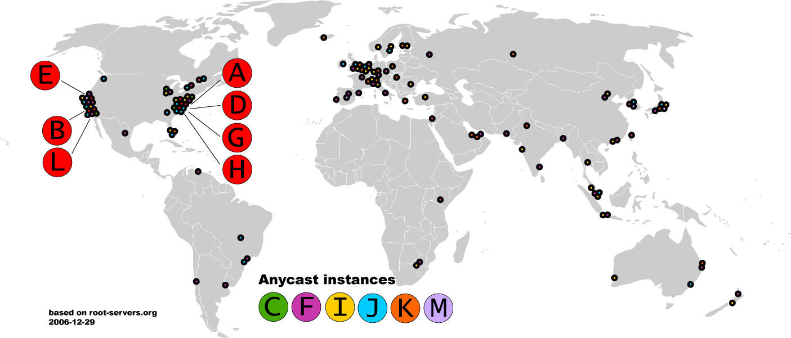
Old Map of the Roots

Slide 17
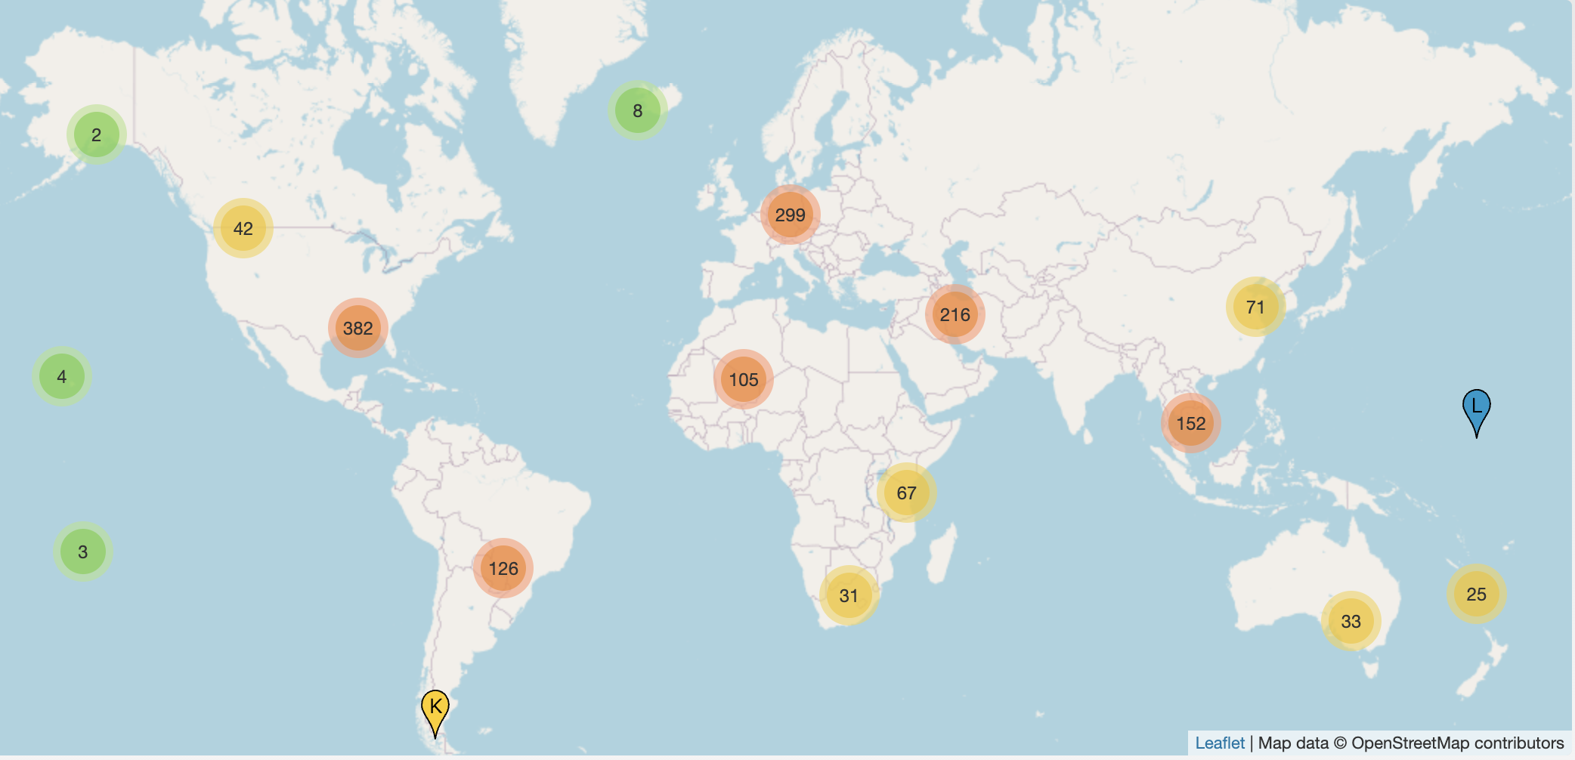
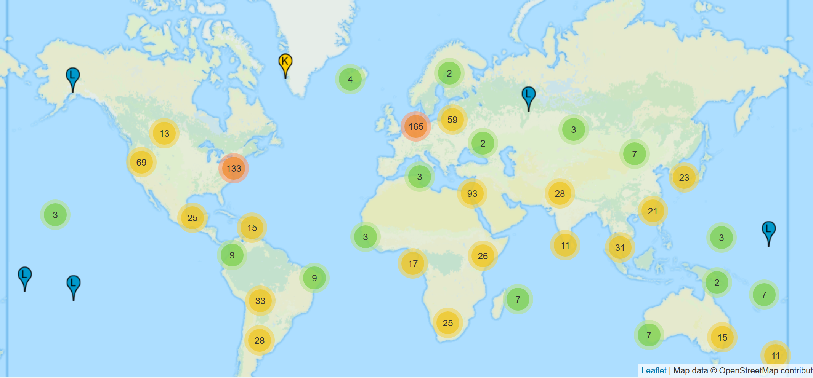
(Newer) Map of the Roots
Notes:
As of 2025-10-24T17:11:30Z, the root server system consists of 1999 instances operated by the 12 independent root server operators.

Slide 18
Exercise: $ dig
; <<>> DiG 9.10.6 <<>>
;; global options: +cmd
;; Got answer:
;; ->>HEADER<<- opcode: QUERY, status: NOERROR, id: 57991
;; flags: qr rd ra; QUERY: 1, ANSWER: 13, AUTHORITY: 0, ADDITIONAL: 1
;; OPT PSEUDOSECTION:
; EDNS: version: 0, flags:; udp: 4096
;; QUESTION SECTION:
;. IN NS
;; ANSWER SECTION:
. 95556 IN NS k.root-servers.net.
. 95556 IN NS a.root-servers.net.
. 95556 IN NS f.root-servers.net.
. 95556 IN NS l.root-servers.net.
. 95556 IN NS g.root-servers.net.
. 95556 IN NS j.root-servers.net.
. 95556 IN NS b.root-servers.net.
. 95556 IN NS e.root-servers.net.
. 95556 IN NS h.root-servers.net.
. 95556 IN NS m.root-servers.net.
. 95556 IN NS d.root-servers.net.
. 95556 IN NS c.root-servers.net.
. 95556 IN NS i.root-servers.net.
...

Slide 19



Local Nameserver and Authorities
www.google.com
Where is www.google.com?
Local nameserver
Authority for *google.com
Local nameserver handles queries on behalf of clients
Authoritative nameservers know the zone mappings for a subset of the hierarchy
ns1.google.com
asgard.ccs.neu.edu
Authority for *.com
com
Root nameserver
Root

Slide 20
Basic Domain Name Resolution
Every host knows a local DNS server, send all queries to it
  Sometimes known as a recursive resolver
If the local DNS can answer the query, then you’re done
  Local server is also the authoritative server for that name
  Local server has cached the record for that name
Otherwise, go down the hierarchy and recursively search for the authoritative name server
  Every local DNS server knows the root servers
  Use cache to skip steps if possible
    e.g., skip the root and go directly to .edu if the root file is cached

Slide 21
DNS Packet Format
Query/response?
Authoritative/non-authoritative response?
Success/failure?
ID number used to match requests and responses
0
16
32
TxID | Flags
Question Count | Answer Count
Authority Count | Additional Record Count
Question and answer data (Resource Records, variable length)
How many records are there of each type in the response payload?
DNS is a UDP-based protocol on port 53
  No TCP means no connections
  TxIDs are needed to correlate requests and responses
  Serves as authentication for responses

Slide 22
Glue Records
DNS responses may contain more than a single answer
Example: resolving cyclic dependency
TxID: 5678
Q: 1 | A: 0
Auth: 1 | Addl: 1
Q: Where is .com?
Auth: NS a.gtld-server.com
Addl: A a.gtld-server.com 12.56.10.1
TxID: 5678
Q: 1 | A: 0
Auth: 0 | Addl: 0
Q: Where is .com?
asgard.ccs.neu.edu
Root
Known as glue records
Additional responses can contain any type of record (i.e. A, NS, etc.)

Slide 23

DNS Resolution Example
www.google.com
Where is www.google.com?
TxID: 12347
Q: 1 | A: 1
Auth: 0 | Addl: 0
Q: Where is www.google.com?
A www.google.com 182.0.7.34
TxID: 12347
Q: 1 | A: 0
Auth: 0 | Addl: 0
Q: Where is www.google.com?
TxID: 12346
Q: 1 | A: 0
Auth: 0 | Addl: 0
Q: Where is www.google.com?
TxID: 12345
Q: 1 | A: 0
Auth: 0 | Addl: 0
Q: Where is www.google.com?
asgard.ccs.neu.edu
ns1.google.com
TxID: 12345
Q: 1 | A: 0
Auth: 1 | Addl: 1
Q: Where is www.google.com?
Auth: NS a.gtld-server.com
Addl: A a.gtld-server.com 12.56.10.1
TxID: 12346
Q: 1 | A: 0
Auth: 1 | Addl: 1
Q: Where is www.google.com?
Auth: NS ns1.google.com
Addl: A ns1.google.com 8.8.0.1
a.gtld-server.com
Root

Slide 24
DNS Queries and Resource Records
DNS queries have two fields: name and type
  Typically, a domain name and type A…
  But there are other types too
Resource record is the response to a query
  Four fields: (name, type, TTL, value)
  There may be multiple records returned for one query
What does the value mean?
  Depends on the type of query and response

Slide 25
DNS Record Types
Name (Query) | Type | Value | Example
Domain Name | A | IPv4 Address | 4700.network A 129.10.123.70
Domain Name | AAAA | IPv6 Address | dns1.registrar-servers.com AAAA 2610:a1:1024::200
Domain Name | CNAME | Domain Name | 5700.network CNAME 4700.network
Domain Name | NS | Domain Name of Auth. Nameserver | 4700.network NS dns1.registrar-servers.com
Domain Name | SOA | Domain ownership information | 4700.network SOA hostmaster.registrar-servers.com

Slide 26
Exercise: $ dig www.khoury.northeastern.edu
; <<>> DiG 9.10.6 <<>> www.khoury.northeastern.edu
;; global options: +cmd
;; Got answer:
;; ->>HEADER<<- opcode: QUERY, status: NOERROR, id: 20630
;; flags: qr aa rd ra; QUERY: 1, ANSWER: 4, AUTHORITY: 0, ADDITIONAL: 1
;; OPT PSEUDOSECTION:
; EDNS: version: 0, flags:; udp: 4096
;; QUESTION SECTION:
;www.khoury.northeastern.edu. IN A
;; ANSWER SECTION:
www.khoury.northeastern.edu. 3600 IN CNAME presscache.khoury.northeastern.edu.
presscache.khoury.northeastern.edu. 3600 IN A 52.70.229.197
...

Slide 27
DNS Record Types
Name (Query) | Type | Value | Example
Domain Name | A | IPv4 Address | 4700.network A 129.10.123.70
Domain Name | AAAA | IPv6 Address | dns1.registrar-servers.com AAAA 2610:a1:1024::200
Domain Name | CNAME | Domain Name | 5700.network CNAME 4700.network
Domain Name | NS | Domain Name of Auth. Nameserver | 4700.network NS dns1.registrar-servers.com
Domain Name | SOA | Domain ownership information | 4700.network SOA hostmaster.registrar-servers.com
IP Address | PTR | Domain Name | 70.123.10.129.in-addr.arpa. PTR achtung-web.ccs.neu.edu.

Slide 28
Reverse Lookups
IP→name mapping
Separate server hierarchy stores reverse mappings
  Rooted at in-addr.arpa and ip6.arpa
Doing an IPv4 lookup:
  Reverse the IP address in question
  Append “.in-addr.arpa”
  dig for the resulting string with type PTR
  4700.network A 129.10.123.70
  $ dig 70.123.10.129.in-addr.arpa PTR

Slide 29
DNS as Indirection Service
DNS gives us very powerful capabilities
  Not only easier for humans to reference machines!
Changing the IPs of machines becomes trivial
  e.g., you want to move your web server to a new host
  Just change the DNS record!

Slide 30
Aliasing and Load Balancing
One machine can have many aliases
www.reddit.com
choffnes.substack.com
www.meta.com
cs3700.substack.com
www.slate.com
*. substack.com
One domain can map to multiple machines
www.google.com

Slide 31


Content Delivery Networks
DNS responses may vary based on geography, ISP, etc

Slide 32
Exercise: $ dig www.northeastern.edu
; <<>> DiG 9.10.6 <<>> www.northeastern.edu
;; global options: +cmd
;; Got answer:
;; ->>HEADER<<- opcode: QUERY, status: NOERROR, id: 31072
;; flags: qr aa rd ra; QUERY: 1, ANSWER: 4, AUTHORITY: 0, ADDITIONAL: 1
;; OPT PSEUDOSECTION:
; EDNS: version: 0, flags:; udp: 4096
;; QUESTION SECTION:
;www.northeastern.edu. IN A
;; ANSWER SECTION:
www.northeastern.edu. 300 IN CNAME northeastern.edu.edgekey.net.
northeastern.edu.edgekey.net. 172 IN CNAME e12215.dscb.akamaiedge.net.
e12215.dscb.akamaiedge.net. 17 IN A 72.247.11.80
e12215.dscb.akamaiedge.net. 17 IN A 72.247.11.50

Slide 33
DNS Propagation
How many of you have purchased a domain name?
  Did you notice that it took ~72 hours for your name to become accessible?
  This delay is called DNS Propagation
Delays for new names and records:
  Communication delays between the registrar and the registry
    Registrar: a domain name reseller, e.g., Godaddy, Namecheap
    Registry: the official administrator of a TLD, e.g., Verisign
  Time to update the registry’s distributed DNS nameservers
Delays for existing names and records:
  Caching and TTL—some ISPs ignore TTLs and cache records for days

Slide 34
Caching vs. Freshness
DNS Propagation delay is caused by caching
Where is
www.my-new-site.com?
That name does not exist.
Cached Root Zone File
Cached .com Zone File
Cached .net Zone File
Etc.
asgard.ccs.neu.edu
Zone files may be cached for 1-72 hours
Root
com
www.my-new-site.com
ns.godaddy.com

Slide 35
Outline
DNS Basics
Case Study: DNS and Email
DNS for Service Discovery

Slide 36
High-level Goals
DNS can be used to find specific services, not just specific names
DNS can store metadata about names

Slide 37
Browsing the Web
By default, DNS queries return A and AAAA records
  IP address
By default, DNS queries do not tell you anything about services or ports
Web browsing example:
  Assume a given host will be running an HTTP server on port 80
  … or an HTTPS server on port 443
northeastern.edu A 155.33.17.68
Authoritative DNS
northeastern.edu
Local DNS
sock.connect(
155.33.17.68,
80
)
155.33.17.68

Slide 38

Sending Email?
By default, DNS queries return A and AAAA records
  IP address
By default, DNS queries do not tell you anything about services or ports
Email example:
  Email uses the Simple Mail Transfer Protocol (SMTP)
  Assume a given host will be running an SMTP server on port 587
northeastern.edu A 155.33.17.68
Authoritative DNS
To: aoun@northeastern.edu
From: biden@whitehouse.gov
Local DNS
sock.connect(
155.33.17.68,
587
)
155.33.17.68

Slide 39
How to Distinguish HTTP from SMTP Servers?
Solution 1: use unique domains
  Example: google.com versus gmail.com
  A records lead to different IP addresses
  Port 80 & 443 open versus 587 (does this work for folks that work at google?)
Solution 2: use unique subdomains
  Example: www.mydomain.com versus mail.mydomain.com
  A records lead to different IP addresses
  Port 80 & 443 open versus 587
  Note: mail would need to be sent to user@mail.mydomain.com
Solution 3: DNS MX type records

Slide 40
DNS Record Types
Name (Query) | Type | Value | Example
Domain Name | A | IPv4 Address | 4700.network A 129.10.123.70
Domain Name | AAAA | IPv6 Address | dns1.registrar-servers.com AAAA 2610:a1:1024::200
Domain Name | CNAME | Domain Name | 5700.network CNAME 4700.network
Domain Name | NS | Domain Name of Auth. Nameserver | 4700.network NS dns1.registrar-servers.com
Domain Name | SOA | Domain ownership information | 4700.network SOA hostmaster.registrar-servers.com
IP Address | PTR | Domain Name | 70.123.10.129.in-addr.arpa. PTR achtung-web.ccs.neu.edu.
Domain Name | MX | Domain Name of the Mail Server | northeastern.edu MX northeastern-edu.mail.protection.outlook.com

Slide 41
Exercise: $ dig google.com MX; dig smtp.google.com
; <<>> DiG 9.18.28-0ubuntu0.24.04.1-Ubuntu <<>> google.com MX
;; global options: +cmd
;; Got answer:
;; ->>HEADER<<- opcode: QUERY, status: NOERROR, id: 50597
;; flags: qr rd ra; QUERY: 1, ANSWER: 1, AUTHORITY: 0, ADDITIONAL: 1
;; OPT PSEUDOSECTION:
; EDNS: version: 0, flags:; udp: 4096
;; QUESTION SECTION:
;google.com. IN MX
;; ANSWER SECTION:
google.com. 300 IN MX 10 smtp.google.com.
; <<>> DiG 9.18.28-0ubuntu0.24.04.1-Ubuntu <<>> smtp.google.com
;; global options: +cmd
;; Got answer:
;; ->>HEADER<<- opcode: QUERY, status: NOERROR, id: 1912
;; flags: qr rd ra; QUERY: 1, ANSWER: 5, AUTHORITY: 0, ADDITIONAL: 1
;; OPT PSEUDOSECTION:
; EDNS: version: 0, flags:; udp: 4096
;; QUESTION SECTION:
;smtp.google.com. IN A
;; ANSWER SECTION:
smtp.google.com. 300 IN A 172.253.62.27
smtp.google.com. 300 IN A 142.251.16.27
smtp.google.com. 300 IN A 64.233.180.26
smtp.google.com. 300 IN A 64.233.180.27
smtp.google.com. 300 IN A 142.251.16.26

Slide 42
Sending Email Using MX Records
By default, DNS queries return A and AAAA records
  IP address
By default, DNS queries do not tell you anything about services or ports
Email example:
  Assume a given host will be running an SMTP server on port 587
northeastern.edu MX northeastern-edu.mail.protection.outlook.com
northeastern-edu.mail.protection.outlook.com A 52.101.10.1
Authoritative DNS
To: aoun@northeastern.edu
From: biden@whitehouse.gov
Local DNS
sock.connect(
52.101.10.1,
587
)
52.101.10.1

Slide 43
What About Receiving Email?
Is it possible to spoof the From: field of an email?
  YES
As originally designed, SMTP does not authenticate the email sender
  From: is just a piece of metadata associated with a given email
Authoritative DNS
To: aoun@northeastern.edu
From: biden@whitehouse.gov
Local DNS
52.101.10.1

Slide 44
SMTP Protocol Example
S: 220 smtp.northeastern.edu ESMTP Postfix
C: HELO relay.whitehouse.gov
S: 250 Hello relay.whitehouse.gov, I am glad to meet you
C: MAIL FROM:<biden@whitehouse.gov>
S: 250 Ok
C: RCPT TO:<aoun@northeastern.edu>
S: 250 Ok
C: DATA
S: 354 End data with <CR><LF>.<CR><LF>
C: From: “Joe Biden" <biden@whitehouse.gov
C: To: “Joseph Aoun" <aoun@northeastern.edu>
C: Date: Tue, 15 Jan 2008 16:02:43 -0500
C: Subject: Greetings
C:
C: Just saying hi from one president to another.
C: Your friend,
C: Joe
C: .
S: 250 Ok: queued as 12345
C: QUIT
S: 221 Bye

Slide 45
Email Source Authentication
Email spoofing (and related problems like spam) are pervasive
There are three protocols that work together to authenticate email sources
  Sender Policy Framework (SPF)
  DomainKeys Identified Mail (DKIM)
  Domain-based Message Authentication, Reporting and Conformance (DMARC)
All three protocols are based in DNS

Slide 46
DNS Record Types
Name (Query) | Type | Value | Example
Domain Name | A | IPv4 Address | 4700.network A 129.10.123.70
Domain Name | AAAA | IPv6 Address | dns1.registrar-servers.com AAAA 2610:a1:1024::200
Domain Name | CNAME | Domain Name | 5700.network CNAME 4700.network
Domain Name | NS | Domain Name of Auth. Nameserver | 4700.network NS dns1.registrar-servers.com
Domain Name | SOA | Domain ownership information | 4700.network SOA hostmaster.registrar-servers.com
IP Address | PTR | Domain Name | 70.123.10.129.in-addr.arpa. PTR achtung-web.ccs.neu.edu.
Domain Name | MX | Domain Name of the Mail Server | northeastern.edu MX northeastern-edu.mail.protection.outlook.com
Domain Name | TXT | Arbitrary string data | northeastern.edu TXT "google-site-verification=59IXaWuy…T6FaLRYegk8xpMyd7WPE"

Slide 47
$ dig northeastern.edu TXT
; <<>> DiG 9.18.28-0ubuntu0.24.04.1-Ubuntu <<>> northeastern.edu TXT
;; global options: +cmd
;; Got answer:
;; ->>HEADER<<- opcode: QUERY, status: NOERROR, id: 23522
;; flags: qr rd ra; QUERY: 1, ANSWER: 32, AUTHORITY: 0, ADDITIONAL: 1
;; OPT PSEUDOSECTION:
; EDNS: version: 0, flags:; udp: 1232
;; QUESTION SECTION:
;northeastern.edu. IN TXT
;; ANSWER SECTION:
northeastern.edu. 3176 IN TXT "facebook-domain-verification=wnkg1ahmyfwe3ddtidvfeic73l2bn1"
northeastern.edu. 3176 IN TXT "miro-verification=75abe0df9c4cbccecced3e859b56e4665cf03267"
northeastern.edu. 3176 IN TXT "logmein-verification-code=ec0fd09d-5452-4ed8-a134-cb1217f42963"
northeastern.edu. 3176 IN TXT "apple-domain-verification=hVKTtg72R0miBtX4"
northeastern.edu. 3176 IN TXT "google-site-verification=59IXaWuyY0NqboYUwCGmYTfH6FaLRYegk8xpMyd7WPE"
northeastern.edu. 3176 IN TXT "adobe-sign-verification=9cbce1c0ef57d5b9da3e4b9175c67249"
northeastern.edu. 3176 IN TXT "Sendinblue-code:c67636a9a828b14961b3410807a673ad"
northeastern.edu. 3176 IN TXT "wpe-verification=nupdengplus"
northeastern.edu. 3176 IN TXT "v=spf1 include:spf1.northeastern.edu include:_spf.qemailserver.com a:c.spf.service-now.com include:spf.protection.outlook.com include:_spf.audienceview.net ip4:74.122.104.0/22 -all"

Slide 48
Sender Policy Framework (SPF)
A DNS TXT record that lists the authorized mail senders for a domain
[domain] TXT “v=spf1 [mechanism1 [mechanism2 [mechanism3 […]]]]”
v=spf1 indicates that this is an SPF version 1 record
Eight mechanisms, each of which can take one of four modifiers
  ip4 and ip6 – specifies an address or range of addresses
  a – sender’s domain resolves to the sender’s IPv4 or IPv6 address
  mx – sender’s MX domain resolves to sender’s IPv4 or IPv6 address
  all – matches all addresses
  include – include the SPF record from another domain
Modifiers are + (accept), - (deny), ~ (accept but mark as spam), and ?

Slide 49
SPF Record Examples
Pro Tip: if you own a domain name and you don’t plan to send mail from it, add an SPF record like this to your domain
SPF Record | Interpretation
4700.network TXT “v=spf1 -all" | Deny all mail from this domain
cbw.sh TXT “v=spf1 ip4:54.210.98.79 -all" | Accept mail from the given IPv4 address, deny from all others
example.com TXT “v=spf1 ip4:128.33.17.0/22 -all" | Accept mail from the given range of IPv4 addresses, deny from all others
example.com TXT “v=spf1 a -all" | Resolve the A/AAAA records for example.com and accept mail from any of those addresses, deny from all others
example.com TXT “v=spf1 ~all" | Accept mail from any address but label it as spam
northeastern.edu TXT “v=spf1 include:spf.protection.outlook.com -all" | Include the SPF rules from outlook.com, deny from all others

Slide 50

SPF Example
whitehouse.gov TXT “v=spf1 ip4:214.3.140.22/32 ~all"
Query the TXT records for the sender’s domain
Is the sender’s IP address authorized in the domain’s SPF record?
  If yes, accept the mail
  If not, drop the mail or mark it as spam
Authoritative DNS
To: aoun@northeastern.edu
From: biden@whitehouse.gov
6.6.6.0
Local DNS
6.6.6.0 does not match 214.3.140.22
Mark this mail as spam (~all)
smtp.northeastern.edu

Slide 51
DomainKeys Identified Mail (DKIM)
Cryptographic scheme to prevent mail spoofing
Uses public key (asymmetric) cryptography
  Sender publishes their public key in a DNS TXT record
  Sender cryptographically signs outgoing mail their private key
  Receiver authenticates signatures in incoming mail by looking up the sender’s public key from DNS
[selector]._domainkey.[domain] TXT “v=DKIM1 p=[public key]”

Slide 52
DKIM Record Example
DKIM Header in Email
DKIM DNS Record
v=1;
a=rsa-sha256;
d=example.com;
s=mailverification;
h=from:to:subject;
bh=[SHA256 hash of the email body and chosen headers];
b=[RSA cryptographic signature]
mailverification._domainkeys.example.com TXT “v=DKIM1 p=[RSA public key]”

Slide 53
Domain-based Message Authentication, Reporting and Conformance (DMARC)
Offers domain owners two capabilities
  Tell receivers what to do if mail from the sender’s domain fails SPF and/or DKIM checks
  Get reports from receivers about SPF and DKIM failures
_dmarc.[domain] TXT “v=DMARC1; [key=value; [key=value; […]]]”
Ten possible keys, each with their own options

Slide 54
DMARC Record Examples
DMARC Record | Interpretation
_dmarc.example.com TXT “v=DMARC1; p=quarantine; adkim=s; aspf=r;” | Strictly check DKIM. Do relaxed checking of SPF. Mails that fail checks should be quarantined (marked as spam)
_dmarc.example.com TXT “v=DMARC1; p=reject; adkim=s; aspf=s;” | Strictly check SPF and DKIM. Mails that fail either should be rejected
_dmarc.example.com TXT “v=DMARC1; p=none; sp=reject” | Do not check SPF or DKIM for mails from example.com. Reject mails from subdomains of example.com that fail SPF/DMARC.
_dmarc.example.com TXT “v=DMARC1; p=quarantine; pct=50; rua=mailto:dmarcreports@example.com” | 50% of mails that fail SPF/DMARC should be quarantined; deliver the rest. Email failure reports to the given address.

Slide 55
Takeaways
DNS can do more than just resolve domain names to IP addresses
DNS can resolve services
  Where is the email server for a given domain?
DNS can host arbitrary meta-data for a domain
  Is this domain allowed to send email?
  How should sender’s handle mail failures from a sending domain?
  Verify the authenticity of mail from a sending domain

Slide 56
Outline
DNS Basics
DNS and Email
DNS and HTTP/S

Slide 57
Using DNS for Service Resolution
MX records allow clients to locate mail servers for a given domain
Limitations:
  Only works for locating SMTP servers, what about other services?
    HTTP/S, FTP, SSH, etc.
  No ability to specify port numbers
    Client must still assume that default ports are being used
    Example: SMTP may use port 25, 465, or 587
  No ability to specify protocol details
    SMTP or Extended SMTP (ESMTP)?
    SMTP with or without encryption, e.g., TLS?

Slide 58
Browsing the Web, Again
DNS query returns A/AAAA records
What port should the browser connect to?
  80 for HTTP?
  443 for HTTPS (i.e., HTTP/TLS)?
What version of the HTTP protocol does the server support?
  HTTP/1.1, HTTP/2, HTTP/3?
  If HTTP/1.1, with or without TLS?
northeastern.edu A 155.33.17.68
Authoritative DNS
User did not type a full URL with a scheme, i.e., http:// or https://
northeastern.edu
Local DNS
sock.connect(
155.33.17.68,
???
)
155.33.17.68

Slide 59
DNS Record Types
Name (Query) | Type | Value | Example
Domain Name | A | IPv4 Address | 4700.network A 129.10.123.70
Domain Name | AAAA | IPv6 Address | dns1.registrar-servers.com AAAA 2610:a1:1024::200
Domain Name | CNAME | Domain Name | 5700.network CNAME 4700.network
Domain Name | NS | Domain Name of Auth. Nameserver | 4700.network NS dns1.registrar-servers.com
Domain Name | SOA | Domain ownership information | 4700.network SOA hostmaster.registrar-servers.com
IP Address | PTR | Domain Name | 70.123.10.129.in-addr.arpa. PTR achtung-web.ccs.neu.edu.
Domain Name | MX | Domain Name of the Mail Server | northeastern.edu MX northeastern-edu.mail.protection.outlook.com
Domain Name | TXT | Arbitrary string data | northeastern.edu TXT "google-site-verification=59IXaWuy…T6FaLRYegk8xpMyd7WPE"
Domain Name | SRV | Port and domain for a given service | _mail._tcp.example.com SRV 0 100 587 mail.example.com
Domain Name | SVCB | Port, domain, and application-level protocol(s) for a given service | example.com HTTPS 1 www.example.com port=8000 alpn=h2,h3

Slide 60
DNS Service Record (SRV)
Intended to facilitate service discovery
_[service]._[udp|tcp].[domain] SRV [priority] [weight] [port] [target domain]
Transport protocol
Service name, e.g., LDAP, SIP, XMPP, etc.
Used to choose between multiple SRV records for a given service
Connect your socket to this domain and port!

Slide 61
Browsing the Web with SRV
_http._tcp.northeastern.edu SRV 80 www.northeastern.edu
_https._tcp.northeastern.edu SRV 443 www.northeastern.edu
www.northeastern.edu A 155.33.17.68
DNS query returns A/AAAA and SRV records
What version of the HTTP protocol does the server support?
  HTTP/1.1, HTTP/2, HTTP/3?
Authoritative DNS
User did not type a full URL with a scheme, i.e., http:// or https://
northeastern.edu
Local DNS
sock.connect(
155.33.17.68,
443
)
155.33.17.68

Slide 62
DNS Service Binding Record (SVCB)
Also intended to facilitate service discovery
[domain] SVCB [priority] [target] [key=value [key=value […]]]
0 means this is an alias (i.e., a CNAME)
>0 used to select most preferred record
Target domain name. Dot (“.”) means the queried domain.
Service-specific information, encoded as key-value pairs

Slide 63
DNS HTTPS Record (HTTPS)
Subtype of SVCB record just for HTTPS services
[domain] HTTPS [priority] [target] alpn=[http/1.1|h2|h3] port=[integer] ech=[key]
Application layer protocol, i.e., what versions of HTTP are supported by the server?
Port number
Public cryptographic key used to bootstrap TLS

Slide 64
Browsing the Web with SVCB/HTTPS
northeastern.edu HTTPS 10 www.northeastern.edu alpn=http/1.1,h2 port=443
www.northeastern.edu A 155.33.17.68
DNS query returns A/AAAA and HTTPS records
Authoritative DNS
User did not type a full URL with a scheme, i.e., http:// or https://
northeastern.edu
Local DNS
sock.connect(
155.33.17.68,
443
)
155.33.17.68

Slide 65
Advanced Service Resolution with DNS
SRV Record Type
SVCB Record Type
Requires a service name, transport protocol, and domain name to lookup the SRV records
Requires domain to lookup the SVCB records
Returns port and target domain name of the service
Returns port, target domain, and service-specific metadata for the given service
Not well supported by applications, especially web browsers
Supported by web browsers

Slide 66
Outline
Wrapup

Slide 67
Much More to DNS
DNS privacy and security
  Subject of a later lecture
Caching: when, where, how much, etc.
Other uses for DNS (i.e., DNS hacks)
  Content Delivery Networks (CDNs) and load balancing
  Dynamic DNS (e.g., for mobile hosts)
DNS and botnets
Politics and growth of the DNS system
  Governance
  New TLDs (.xxx, .biz), eliminating TLDs altogether
  Copyright, arbitration, squatting, typo-squatting

