Slide 1
CS 4700
Network Fundamentals
Lecture 2: History
(Hint: Al Gore *did* have a small role)
Revised 1/7/2026

Slide 2

What is a communications network
Give an example of a Communications Network: a current one or from the past
Notes:
https://forms.office.com/Pages/DesignPageV2.aspx?prevorigin=shell&origin=RevampFRE&subpage=design&id=gcLuqKOqrk2sm5o5i5IV5xlyN-cCcFNNvZZ2_f2aN2pUMkxVMDNHRkxQRUoxVTkzSUxDVks5VVNYUC4u&analysis=true

Slide 3
What is a Communication Network?
A communications network is a network of links and nodes arranged so that messages may be passed from one part of the network to another
What are nodes and links?
  People and roads
  Telephones and switches
  Computers and routers
What is a message?
  Information
Networks are key for:
Speed
Distance

Slide 4
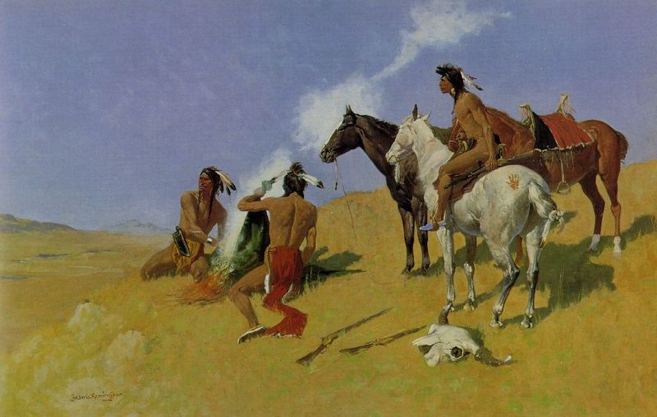
Networks are Fundamental
Smoke Signals!

Slide 5
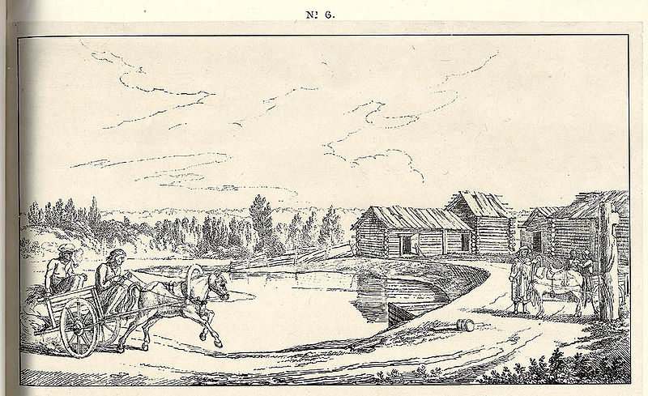
Networks are Old
2400 BC: courier networks in Egypt
550 BC: postal service invented in Persia
Problems:
Speed
Reliability
Security

Slide 6
Towards Electric Communication
1837: Telegraph invented by Samuel Morse
  Distance: 10 miles
  Speed: 10 words per minute
  In use until 1985!
Key challenge: how to encode information?
  Originally used unary encoding
    A • B •• C ••• D •••• E •••••
  Next generation: binary encoding
    A •– B –••• C –•–• D –•• E •
Higher compression = faster speeds

Slide 7
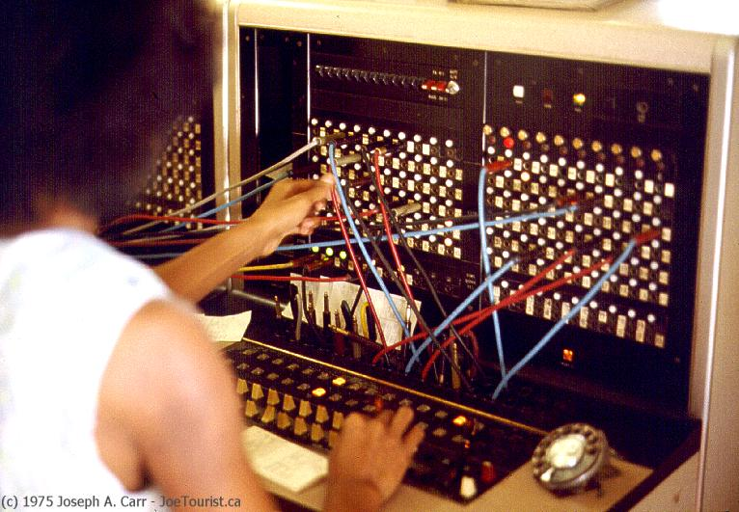


Telephony
1876 – Alexander Graham Bell invents the telephone
Key challenge: how to scale the network?
  Originally, all phones were directly connected
    O(n²) complexity; n*(n–1)/2
  1878: Switching
  1937: Trunk lines + multiplexing
Advantages
Easy to use
Switching mitigates complexity
Makes cable management tractable
Problems
Manual switching
1918: cross country call took 15 minutes to set up

Slide 8
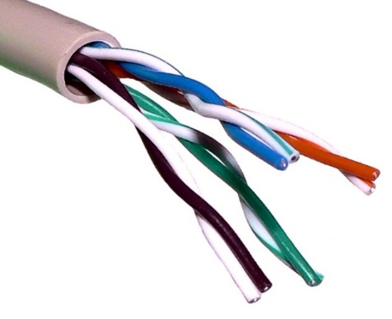
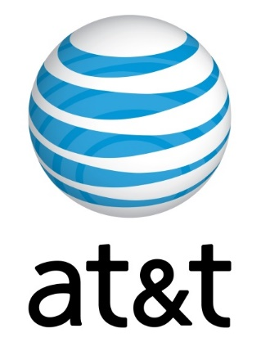
Growth of the Telephone Network
1881: Twisted pair for local loops
1885: AT&T formed
1892: Automatic telephone switches
1903: 3 million telephones in the US
1915: First transcontinental cable
1927: First transatlantic cable
1937: first round-the-world call
1946: National numbering plan

Slide 9
Evolution of switching
Telephone networks are circuit switched
  Each call reserves resources end-to-end
  Provides excellent quality of service
Problems
  Resource intense (what if the circuit is idle?)
  Complex network components (per circuit state, security)
Packet switching
  No connection state, network is store-and-forward
  Minimal network assumptions
  Statistical multiplexing gives high overall utilization

Slide 10
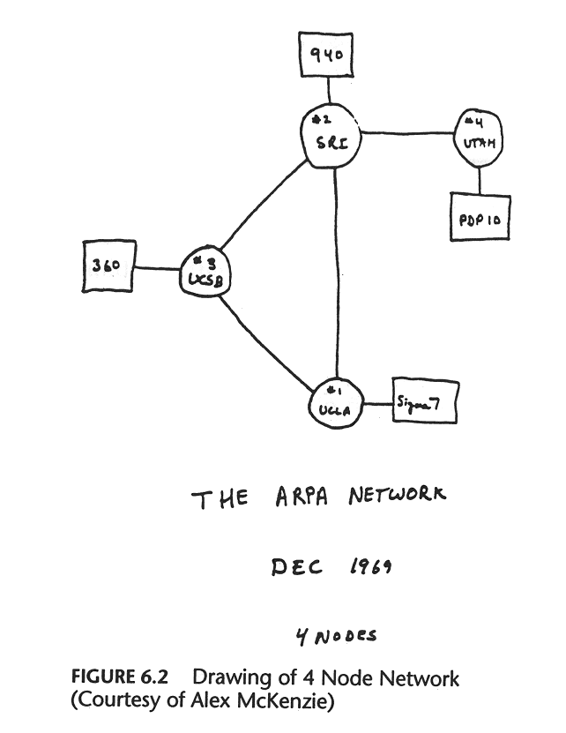
The World’s Most Successful Computer Science Research Project

Slide 11
A Brief History of the Early Internet
1961
1962
Licklider’s vision of Galactic Network
1965
Roberts connects computers over phone line
1967
Roberts publishes vision of ARPANET
1969
BBN installs first InterfaceMsgProcessor at UCLA
1970
Network Control Protocol (NCP)
1972
Public demonstra-tion of ARPANET
1972
Kahn @ DARPA advocates Open Architecture
1972
Vint Cerf @ Stanford writes TCP
Kleinrock @ MIT: packet-switched network

Slide 12
History of the Internet
1961: Kleinrock @ MIT: packet-switched network
1962: Licklider’s vision of Galactic Network
1965: Roberts connects computers over phone line
1967: Roberts publishes vision of ARPANET
1969: BBN installs first InterfaceMsgProcessor at UCLA
1970: Network Control Protocol (NCP)
1972: Public demonstration of ARPANET
1972: Kahn @ DARPA advocates Open Architecture
1972: Vint Cerf @ Stanford writes TCP

Slide 13
The Internet, Explained by Vint Cerf
Vint Cerf on Colbert Report (Part 1)

Slide 14
Lessons from Vint Cerf
  Internet originally designed for C&C
  Computers make mistakes
    How do we keep the world safe when mistakes can now happen at a global scale
  Why wasn’t the Internet safer?
    It was an experiment, not expected to go outside academic/military use
    Experiment is still ongoing!
  Internet openness (we need to keep it that way)
  Still billions of people who are not online yet
    Many don’t have traditional computers, most new online users are coming via mobile
  Internet “turned on” in 1983
  Original Internet growth came via National Science Foundation (NSF)

Slide 15
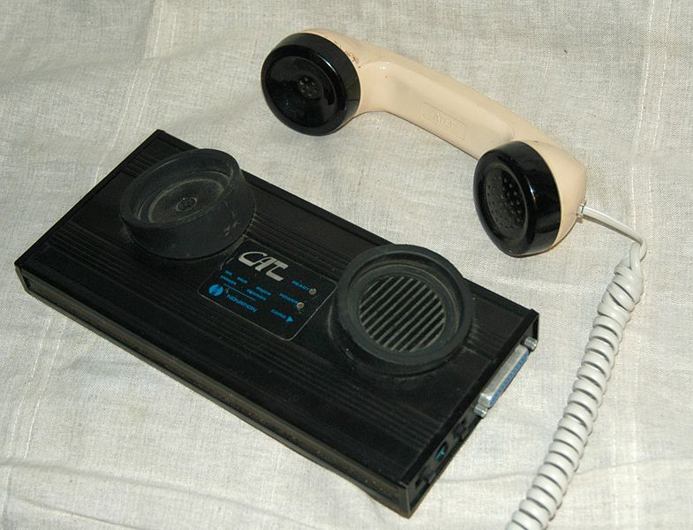
From Humans to Computers
1958: First use of a modem
  Machine to machine communication
  Analog vs. digital signals
Many different computer networks
  Local vs. global
    LAN, WAN
  Private vs. public
    Internet2, NIPRNet
  General purpose vs. special purpose
    E.g. credit cards, banks, defense
  Technology
    Satellite, Copper, Fiber
    Circuit switched, packet switched

Slide 16
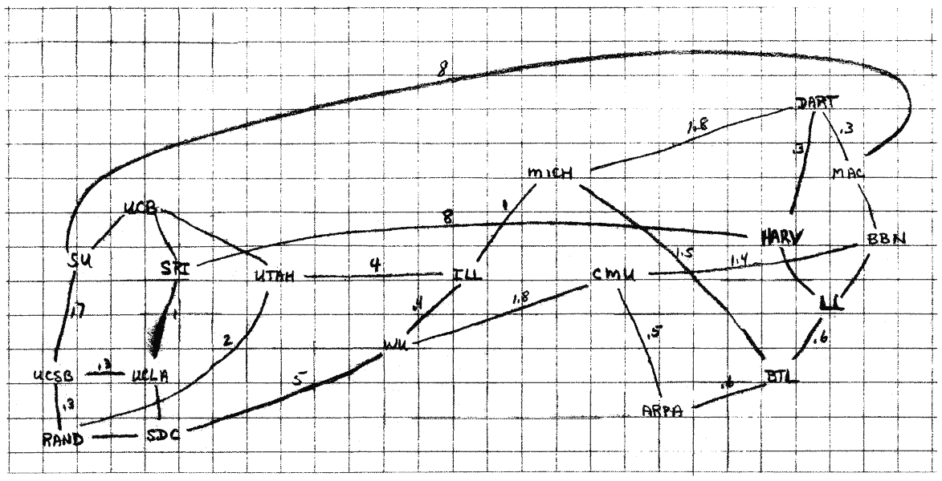
The 1960s

Slide 17
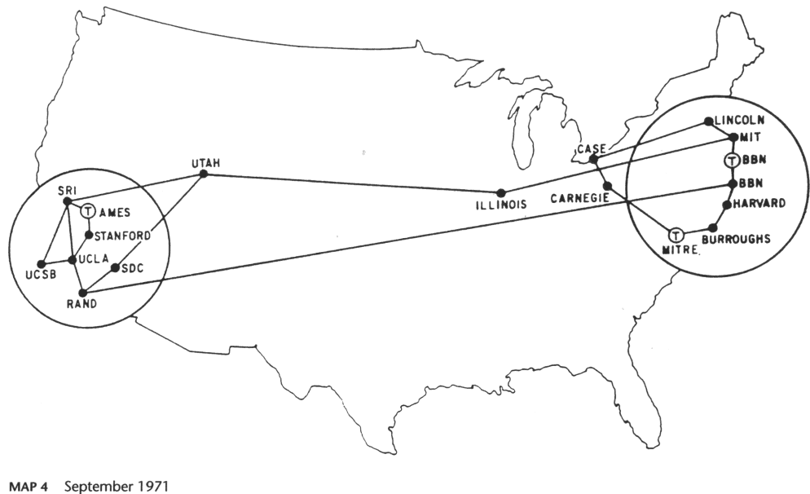
1971

Slide 18
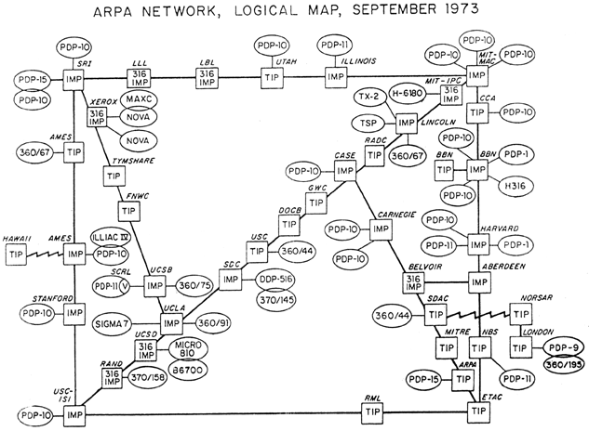
1973

Slide 19
More from Vint
Vint Cerf on Colbert Report (Part 2)

Slide 20
Lessons from Vint Cerf (2)
  Started out as scientists building the Internet, now engineers
  How many things are on the Internet
    We don’t know!
  We ran out of addresses (unique names) for them

Slide 21
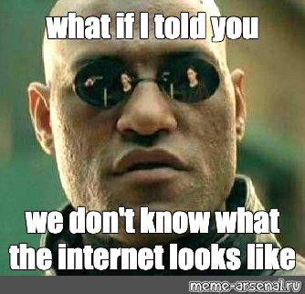
So what does the Internet look like?

Slide 22
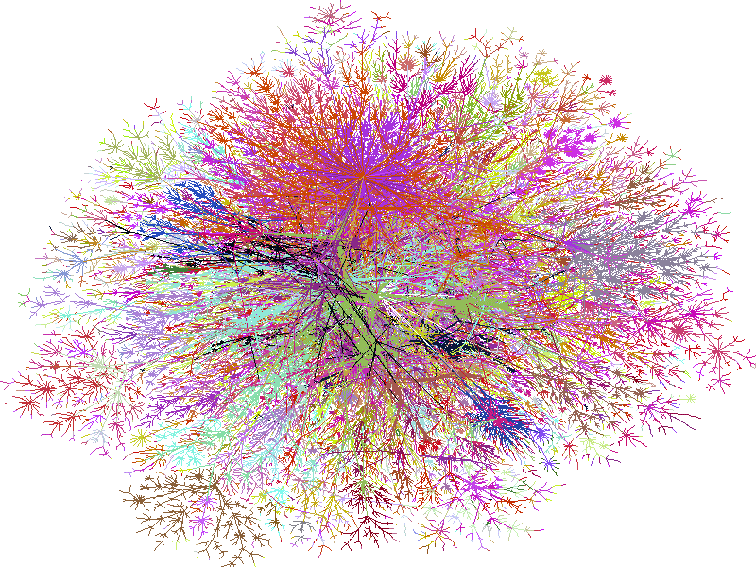
2000

Slide 23
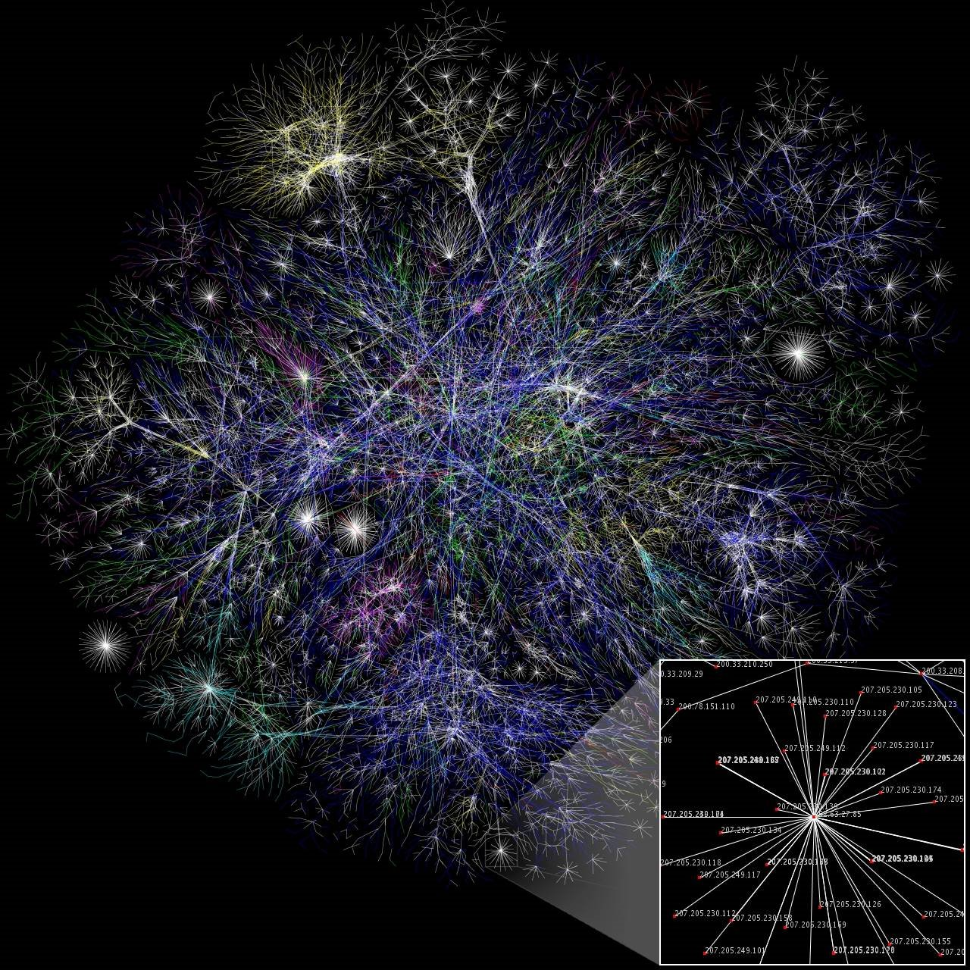
2006

Slide 24

2009

Slide 25
2017
West Asia
Middle East / South Asia
Oceania
https://www.caida.org/research/topology/as_core_network/pics/2017/ascore-2017-feb-ipv4-poster-2048x1518.png
Europe
US West Coast
US East Coast & South America

Slide 26
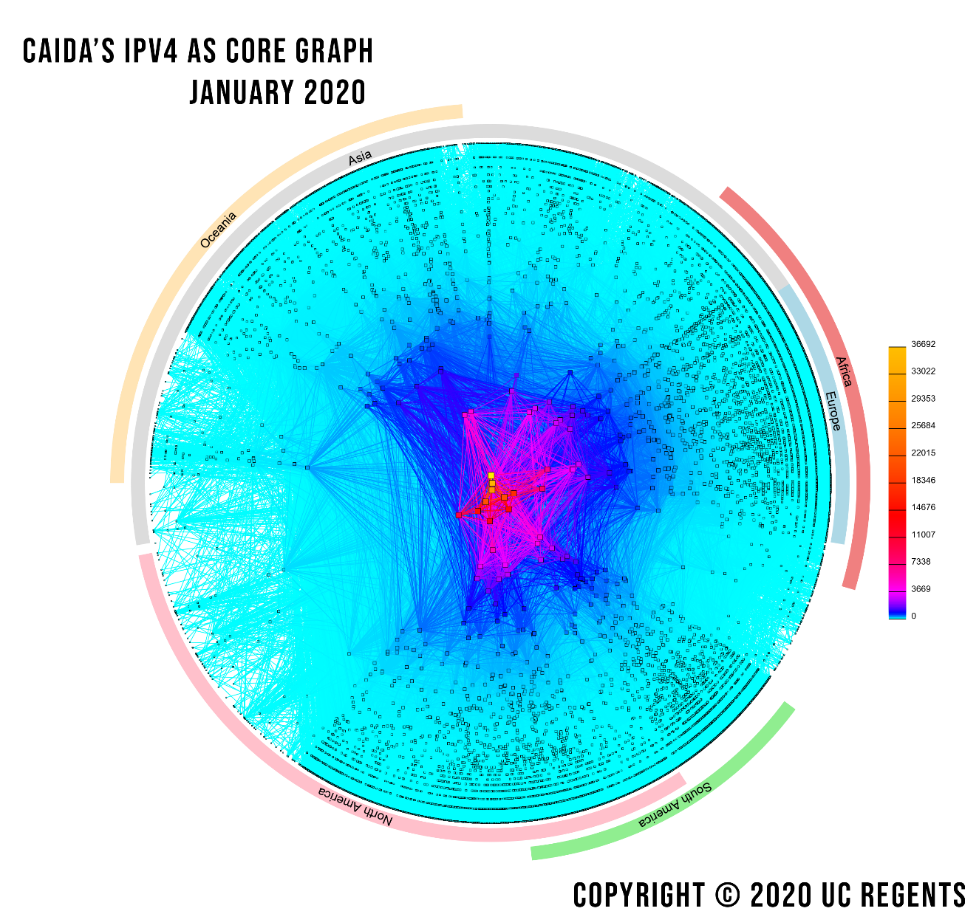
Notes:
From https://www.caida.org/projects/as-core/pics/2020/ascore-2020-ipv4-standalone.png

Slide 27


Growing Pains
Problem: early networks used incompatible protocols

Slide 28
Kahn’s Ground Rules
Each network is independent, cannot be forced to change
Best-effort communication (i.e. no guarantees)
Routers connect networks
No global control
Principles behind the development of IP
Led to the Internet as we know it
Internet is still structured as independent networks

Slide 29

The Birth of Routing
Trivia
Kahn believed that there would only be ~20 networks.
He was way off.
Why?

Slide 30
Internet Applications Over Time
1972
1973
1982
1985
1989
1991
1995
1995-1997
1998
1999
2000s
2010s
2020s
Email
Telnet – remote access to computing
DNS – “phonebook” of the Internet
FTP – remote file access
NFS – remote file systems
The World Wide Web (WWW) goes public
SSH – secure remote shell access
Instant messaging (ICQ, AIM)
Google
Napster, birth of P2P, invented by Shawn Fanning at NEU
BitTorrent, Facebook, YouTube, Twitter, iPhone/Android, Bitcoin
Rise of Internet of Things (IoT), mobile apps, AR/VR, Cloud services
Videoconferencing, telehealth, contact tracing, GenAI

Slide 31
Internet Applications Over Time
1972: Email
1973: Telnet – remote access to computing
1982: DNS – “phonebook” of the Internet
1985: FTP – remote file access
1989: NFS – remote file systems
1991: The World Wide Web (WWW) goes public
1995: SSH – secure remote shell access
1995-1997: Instant messaging (ICQ, AIM)
1998: Google
1999: Napster, birth of P2P
2000s: Bittorrent, Facebook, YouTube, Twitter, iPhone/Android, Bitcoin
2010s: Rise of Internet of Things (IoT), mobile apps, AR/VR, Cloud services
2020: Videoconferencing, telehealth, contact tracing
What is next?
Invented by Shawn Fanning at NEU

Slide 32
More Internet History
1974
1980
1983
1983
198x
1986
1987
1988
199x
1994
1999-present
2007
2014-2016
2010’s
Cerf and Kahn paper on TCP (IP kept separate)
TCP/IP adopted as defense standard
ARPANET and MILNET split
Global NCP to TCP/IP flag day
Internet melts down due to congestion
Van Jacobson saves the Internet (BSD TCP)
NSFNET merges with other networks
Deering and Cheriton propose multicast
QoS rises and falls, ATM rises and falls
NSF backbone dismantled, private backbone
The Internet boom and bust … and boom …
Release of iPhone, rise of Mobile Internet
Rise and fall of net neutrality in the US
Rise of software-defined networks, smart homes
202x
Videoconferencing, telehealth AR/VR, streaming
2021-2025
Rise of LLMs
2nd rise and fall of net neutrality in the US

Slide 33
More Internet History
1974: Cerf and Kahn paper on TCP (IP kept separate)
1980: TCP/IP adopted as defense standard
1983: ARPANET and MILNET split
1983: Global NCP to TCP/IP flag day
198x: Internet melts down due to congestion
1986: Van Jacobson saves the Internet (BSD TCP)
1987: NSFNET merges with other networks
1988: Deering and Cheriton propose multicast
199x: QoS rises and falls, ATM rises and falls
1994: NSF backbone dismantled, private backbone
1999-present: The Internet boom and bust … and boom
2007: Release of iPhone, rise of Mobile Internet
2014-2016: Rise and fall of net neutrality in the US
2010’s: Rise of software-defined networks, smart homes
202x: Videoconferencing, telehealth, AR/VR, the “M” word

Slide 34
Enough about history
This is not a history course
The Internet is constantly evolving
I will teach you about
  The principles on which it was founded
  The fundamental protocols that drive it
  The various applications built atop it
  How these networks are deployed today
  Future directions it might go

Slide 35
Takeaways
Communication is fundamental to human nature
Key concepts have existed for a long time
  Speed/bandwidth
  Latency
  Switching
  Packets vs. circuits
The Internet has changed the world
  Promise of free ($) and free (freedom) communication
What made the Internet so successful? Stay tuned!
  Encoding
  Cable management
  Multiplexing
  Routing

