Slide 2
Exercises
What are the CIDR representations of these networks?
  18.0.19.0/255.255.255.0 82.192.0.0/255.192.0.0
  182.16.0.0/255.255.254.0 129.10.17.64/255.255.254.128
What are the subnet mask representations of these networks?
  56.39.0.0/16 93.32.0.0/13
  194.17.4.0/22 0.0.0.0/0

Slide 3
More exercises
Suppose you were given the network 18.32.0.0/15. You need to divided it into two equal pieces. How do you do so and what are those network addresses in CIDR notation?
What if you were given the network 165.17.14.0/23. How would you divide it?

Slide 4
Even more exercises
Suppose you are a router and your routing table is shown at left. Can you aggregate any of those rules? If so, show the updated rule(s).
Destination | Next Hop
0.0.0.0/0 | Port 1
129.10.128.0/24 | Port 2
129.10.130.0/23 | Port 3
129.10.127.0/24 | Port 2
129.10.0.0/17 | Port 4
129.10.129.0/24 | Port 2

Slide 5
CS 4700
Network Fundamentals
Intra Domain Routing
Revised 2/6/25

Slide 6
Network Layer, Control Plane
Function:
  Set up routes within a single network
Key challenges:
  Distributing and updating routes
  Convergence time
  Avoiding loops
Data Plane
Application
Presentation
Session
Transport
Network
RIP
OSPF
BGP
Control Plane
Data Link
Physical

Slide 7
Internet Routing
Internet organized as a two-level hierarchy
First level – autonomous systems (AS’s)
  AS – region of network under a single administrative domain
  Examples: Comcast, AT&T, Verizon, T-Mobile, etc.
  AS’s use intra-domain routing protocols internally
  Distance Vector, e.g., Routing Information Protocol (RIP)
  Link State, e.g., Open Shortest Path First (OSPF)
Second level – connections between AS’s use inter-domain routing protocols
  Border Gateway Routing (BGP)
  De facto standard today, BGP-4

Slide 8



AS Example
AS-1
AS-3
Interior Routers
AS-2
BGP Routers

Slide 9
Why Do We Have ASs?
History – the Internet started as a network of networks
Routing algorithms are not efficient enough to execute on the entire Internet topology
Different organizations may use different routing policies
Allows organizations to hide their internal network structure
Allows organizations to choose how to route across each other (BGP)
Easier to compute routes
Greater flexibility
More autonomy/independence

Slide 10
Routing on a Graph
Goal: determine a “good” path through the network from source to destination
What is a good path?
  Usually means the shortest path
  Load balanced
  Lowest $$$ cost
Network modeled as a graph
  Routers → nodes
  Link → edges
    Edge cost: delay, congestion level, etc.
5
3
B
C
5
2
A
2
1
F
3
1
D
E
2
1

Slide 11
Routing Problems
Assume
  A network with N nodes
  Each node only knows
    Its immediate neighbors
    The cost to reach each neighbor
How does each node learn the shortest path to every other node?
5
3
B
C
5
2
A
2
1
F
3
1
D
E
2
1

Slide 12
Intra-domain Routing Protocols
Link state
  Open Shortest Path First (OSPF), based on Dijkstra
  Each router periodically floods immediate reachability information to all other routers
  Per router local computation to determine full routes
Distance vector
  Routing Information Protocol (RIP), based on Bellman-Ford
  Routers periodically exchange reachability information with neighbors

Slide 13
Outline
Link State Routing
  OSPF
  IS-IS
Distance Vector Routing
  RIP

Slide 14
Link State Routing
Each node knows its connectivity and cost to direct neighbors
Each node tells every other node this information
Each node learns complete network topology
Use Dijkstra to compute shortest paths

Slide 15
Flooding Details
Each node periodically generates Link State Packet
  ID of node generating the LSP
  List of direct neighbors and costs
  Sequence number (64-bit, assumed to never wrap)
  Time to live
Flood is reliable (ack + retransmission)
Sequence number “versions” each LSP
Receivers flood LSPs to their own neighbors
  Except whoever originated the LSP
LSPs sent when link states change

Slide 16
Dijkstra’s Algorithm
Step | S | →B | →C | →D | →E | →F
0 | A | 2, A | 5, A | 1, A | ∞ | ∞
1 | AD |  | 4, D |  | 2, D | ∞
2 | ADE |  | 3, E |  |  | 4, E
3 | ADEB
4 | ADEBC
5 | ADEBCF
5
…
Loop
find w not in S s.t. D(w) is a minimum;
add w to S;
update D(v) for all v adjacent
  to w and not in S:
D(v) = min( D(v), D(w) + c(w,v) );
until all nodes in S;
3
Initialization:
S = {A};
for all nodes v
if v adjacent to A
then D(v) = c(A,v);
else D(v) = ∞;
…
B
C
5
2
A
2
1
F
3
1
2
D
E
1

Slide 17
OSPF vs. IS-IS
Two different implementations of link-state routing
OSPF
IS-IS
Favored by companies, datacenters
More optional features
Built on top of IPv4
  LSAs are sent via IPv4
  OSPFv3 needed for IPv6
Favored by ISPs
Less “chatty”
  Less network overhead
  Supports more devices
Not tied to IP
  Works with IPv4 or IPv6

Slide 18
Different Organizational Structure
OSPF
IS-IS
Organized around overlapping areas
Area 0 is the core network
Organized as a 2-level hierarchy
Level 2 is the backbone
Area 1
Area 2
Level 1
Level 1-2
Level 2
Area 0
Area 4
Area 3

Slide 19
Outline
Link State Routing
  OSPF
  IS-IS
Distance Vector Routing
  RIP

Slide 20
Distance Vector Routing
What is a distance vector?
  Current best cost to reach all known destinations
Idea: exchange vectors among neighbors to learn about lowest cost paths
No entry for C
Initially, only has info for immediate neighbors
  Other destinations cost = ∞
Eventually, vector is filled
Destination | Cost
A | 7
B | 1
D | 2
E | 5
F | 1
DV Table
at Node C
Routing Information Protocol (RIP)

Slide 21
Distance Vector Routing Algorithm
Wait for change in local link cost or message from neighbor
Recompute distance table
If least cost path to any destination has changed, notify neighbors

Slide 22
Distance Vector Initialization
Node A
Node B
3
B
D
Dest. | Cost | Next
B | 2 | B
C | 7 | C
D | ∞
Dest. | Cost | Next
A | 2 | A
C | 1 | C
D | 3 | D
2
1
1
A
7
C
Initialization:
for all neighbors V do
if V adjacent to A
D(A, V) = c(A,V);
else
D(A, V) = ∞;
…
Node D
Node C
Dest. | Cost | Next
A | 7 | A
B | 1 | B
D | 1 | D
Dest. | Cost | Next
A | ∞
B | 3 | B
C | 1 | C

Slide 23
Distance Vector: 1st Iteration
Node A
Node B
3
B
D
Dest. | Cost | Next
B | 2 | B
C | 7 | C
D | ∞
Dest. | Cost | Next
A | 2 | A
C | 1 | C
D | 3 | D
2
1
1
3
B
A
7
C
8
5
C
B
2
C
…
loop:
…
else if (update D(V, Y) received from V)
for all destinations Y do
if (destination Y through V)
D(A,Y) = D(A,V) + D(V, Y);
else
D(A, Y) =
min(D(A, Y),
D(A, V) + D(V, Y));
if (there is a new min. for dest. Y)
send D(A, Y) to all neighbors
forever
D(A,C) = min(D(A,C), D(A,B)+D(B,C))
= min(7, 2 + 1) = 3
Node C
Node D
D(A,D) = min(D(A,D), D(A,B)+D(B,D))
= min(8, 2 + 3) = 5
D(A,D) = min(D(A,D), D(A,C)+D(C,D))
= min(∞, 7 + 1) = 8
Dest. | Cost | Next
A | 7 | A
B | 1 | B
D | 1 | D
Dest. | Cost | Next
A | ∞
B | 3 | B
C | 1 | C
3
B
4
B

Slide 24
Distance Vector: End of 3rd Iteration
Node A
Node B
3
B
D
Dest. | Cost | Next
B | 2 | B
C | 3 | B
D | 4 | B
Dest. | Cost | Next
A | 2 | A
C | 1 | C
D | 2 | C
2
1
1
A
7
C
…
loop:
…
else if (update D(V, Y) received from V)
for all destinations Y do
if (destination Y through V)
D(A,Y) = D(A,V) + D(V, Y);
else
D(A, Y) =
min(D(A, Y),
D(A, V) + D(V, Y));
if (there is a new min. for dest. Y)
send D(A, Y) to all neighbors
forever
Nothing changes, algorithm terminates
Until something changes…
Node C
Node D
Dest. | Cost | Next
A | 3 | B
B | 1 | B
D | 1 | D
Dest. | Cost | Next
A | 4 | C
B | 2 | C
C | 1 | C

Slide 25
loop:
wait (link cost update or update message)
if (c(A,V) changes by d)
for all destinations Y through V do
D(A,Y) = D(A,Y) + d
else if (update D(V, Y) received from V)
for all destinations Y do
if (destination Y through V)
D(A,Y) = D(A,V) + D(V, Y);
else
D(A, Y) = min(D(A, Y), D(A, V) + D(V, Y));
if (there is a new minimum for destination Y)
send D(A, Y) to all neighbors
forever
B
4
1
1
A
50
C
Link Cost Changes,
Algorithm Starts
Algorithm Terminates
Good news travels fast
D | C | N
A | 4 | A
C | 1 | C
D | C | N
A | 1 | A
C | 1 | C
D | C | N
A | 1 | A
C | 1 | C
D | C | N
A | 1 | A
C | 1 | C
Node B
D | C | N
A | 5 | B
B | 1 | B
D | C | N
A | 5 | B
B | 1 | B
D | C | N
A | 2 | B
B | 1 | B
D | C | N
A | 2 | B
B | 1 | B
Node C
Time
Notes:
Change circles to rectangles, don’t block the text

Slide 26
Count to Infinity Problem
Bad news travels slowly
C has a path to A in 5 hops
Thus, D(B,A) = 6 !
However, B does not know the path is C → B → A
DV Announcement Cache
B
60
4
1
Node A
Node C
D | C
B | 4
C | 5
D | C
A | 7
B | 1
A
C
D | C
A | 5
B | 1
50
D | C | N
A | 4 | A
C | 1 | C
D | C | N
A | 6 | C
C | 1 | C
D | C | N
A | 6 | C
C | 1 | C
D | C | N
A | 8 | C
C | 1 | C
Node B
D | C | N
A | 5 | B
B | 1 | B
D | C | N
A | 5 | B
B | 1 | B
D | C | N
A | 7 | B
B | 1 | B
D | C | N
A | 7 | B
B | 1 | B
Node C
Time

Slide 27
Poisoned Reverse (special case of Split Horizon)
If C routes through B to get to A
  C should not tell B about its ’derived’ route to A
  C tells B that D(C, A) = ∞
DV Announcement Cache
B
4
60
1
Node A
Node C
D | C
B | 4
C | ∞
D | C
A | 50
B | 1
A
C
D | C
A | ∞
B | 1
50
Does this completely solve this count to infinity problem?
NO
Multipath loops can still trigger the issue
D | C | N
A | 4 | A
C | 1 | B
D | C | N
A | 60 | A
C | 1 | B
D | C | N
A | 60 | A
C | 1 | B
D | C | N
A | 51 | C
C | 1 | B
Node B
D | C | N
A | 5 | B
B | 1 | B
D | C | N
A | 5 | B
B | 1 | B
D | C | N
A | 50 | A
B | 1 | B
D | C | N
A | 50 | A
B | 1 | B
Node C
Time

Slide 28
Link State vs. Distance Vector
 | Link State | Distance Vector
Message Complexity | O(n²*e) | O(d*n*k)
Time Complexity | O(n*log n) | O(n)
Convergence Time | O(1) | O(k)
Robustness | Nodes may advertise incorrect link costs Each node computes their own table | Nodes may advertise incorrect path cost Errors propagate due to sharing of DV tables
n = number of nodes in the graph
e = number of edges in the graph
d = degree of a given node
k = number of rounds
Which is best?
In practice, it depends.
In general, link state is more popular.

Slide 29
Summary
Link State shortest path routing
  Flood link weights throughout the network, creating a local model of network
  Compute shortest paths as a sum of link weights from global information
  Loop-free as long as every router's LS database is consistent
    Can have transient loops when database not consistent
Distance Vector shortest-path routing
  Each node sends list of its shortest distance to each destination to its neighbors
  Neighbors update their lists; iterate
  Initially weak at adapting to changes
    Problems include count to infinity and loop
    Solutions include poison reverse and split horizon

Slide 30
Takeaways
Routing is a distributed algorithm
  React to changes in the network
  Compute paths through the network
Shortest Path routing
  Metric-based using link costs
  Routers share a common view of path goodness
Commonly used inside an organization (AS)
  Where the common view can be assumed/agreed/enforced
  RIP and OSPF are mostly used as intradomain protocols
Notes:
Inspired by and liberally borrowed from Stevan Savage's slides at https://cseweb.ucsd.edu/classes/fa11/cse123-a/123f11_Lec10.pdf

Slide 31
CS 3700
Networks and Distributed Systems
Exam practice
Revised 10/05/20

Slide 32
Exam practice
State three reasons why bridged Ethernet cannot be scaled to a network the size of the Internet.
Which layer do MAC Addresses work on? What is their purpose?
What are the main differences between a Bridge and a Switch? Make sure to go into detail.
Why is it important for protocols configured on top of Ethernet to have a length field in their header indicating how long the message is?

Slide 33
Exam practice
What would happen if two hosts on an Ethernet shared the same MAC address?
What information is encoded in an IP address? How do you identify that information?
What are the benefits of IPv6 vs. IPv4?

Slide 34
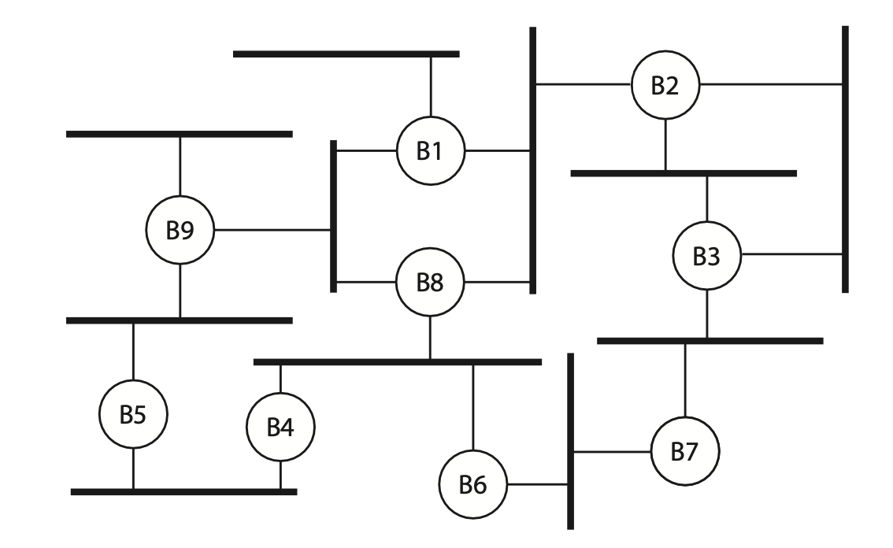
Exam practice
Consider the bridged Ethernet shown at right. Indicate which ports are blocked, root ports, and designated ports. If needed, number the ports.

Slide 35
Exam practice
What happens when an IPv4 packet at the max MTU of one network traverses to a second network with a smaller MTU?
What happens when an IPv6 packet at the max MTU of one network traverses to a second network with a smaller MTU?
What is the “class” of the following IP addresses: (a) 136.54.22.3, (b) 18.29.155.2, (c) 220.12.98.44, and (d) 249.96.44.7

Slide 36
Exam practice
Convert the following IP addresses/subnet masks into CIDR:
128.42.0.0/255.255.0.0 192.168.0.0/255.255.224.0
172.10.12.0/255.255.253.0 64.0.0.0/192.0.0.0
How many IP addresses does each of the networks above hold?
Why does the Offset field in the IP header measure the offset in 8-byte units?

Slide 37
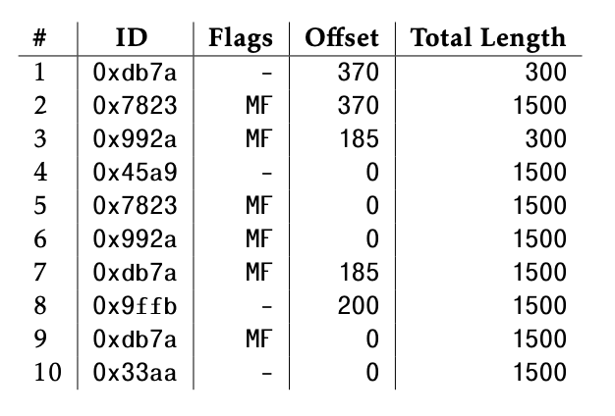
Exam practice
Suppose you receive the following series of IP packets at a destination host (be sure to remember that the length field includes the header). What packet IDs have you completely received (i.e., all fragments of the original packet have been received)?

Slide 38
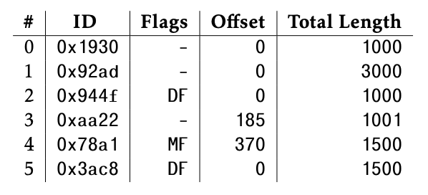
Exam practice
You are a router, and one of your outgoing links has an MTU of 1000 bytes (ignore layer 2 headers). You receive the following packets that all need to be sent out over this link. What will be the packet IDs/flags/offset/total length that you will send out?

Slide 39
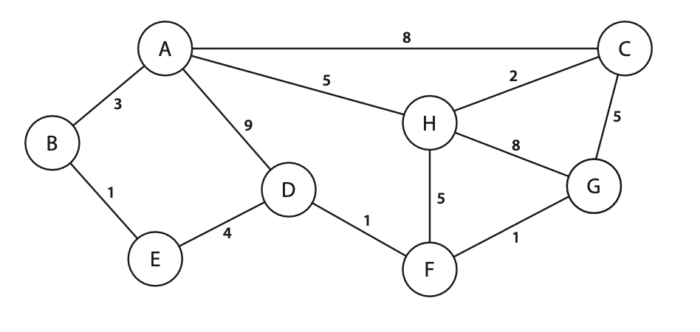
Exam practice
Consider the networking of routers shown below, with the link weight for each link written next to the link. Use Dijkstra's shortest-path algorithm to compute the shortest path from A to all other routers

Slide 40
Exam practice
Name one strength distance vector routing has over link state routing
Name one strength link state routing has over distance vector routing

