Slide 1
CS 4700
Fundamentals of Computer Networks
Lecture 1: Logistics
(a.k.a., setting the ground rules)

Slide 2
Hello!
Welcome to CS 4700
  Are you in the right classroom?
  Okay, good.
Who am I?
  Professor Alden Jackson, Ph.D. (he, his). Please call me Professor Jackson.
  Previous and current research areas: ultra high-speed networks, network architecture, transport protocols, massive distributed system reliability, network security, privacy and Internet censorship mitigation
  awjacks@ccs.neu.edu or a.jackson@northeastern.edu
  https://www.khoury.northeastern.edu/people/alden-jackson/

Slide 3






Places I’ve hung my hat

Slide 4
Hello!
Welcome to CS 4700
  Are you in the right classroom?
  Okay, good.
Who am I?
  Professor David Choffnes
  Director of the Cybersecurity and Privacy Institute at Northeastern
  d.choffnes@northeastern.edu
  https://david.choffnes.com/

Slide 5
What About the Other Sections?
Taught by me too.
  The sections are identical
  Same material, same schedule, same homeworks, same projects
  Feel free to attend either lecture
  Canvas, Piazza, and Gradescope shared across sections

Slide 6
What About the Other Section?
There is another section of CS 4700/5700
  Professor Christo Wilson
  Member of the Cybersecurity and Privacy Institute at Northeastern
  Associate Dean of Undergraduate Programs in Khoury College
  cbw@ccs.neu.edu or c.wilson@northeastern.edu
  https://cbw.sh/
  The two sections are identical
  Same material, same schedule, same homeworks, same projects
  Feel free to attend either lecture (beware: my section has 2 fewer meetings)
  Canvas, Piazza, and Gradescope shared across sections

Slide 7
Anti-Social Media
I’m a privacy researcher, please respect my privacy
  It’s nothing personal
  I need to practice what I preach
  Extremely small social media presence
LinkedIn: I probably won’t add you, so please don’t ask
  Unless you CRUSH the course!

Slide 8
Why Take This Course?
How many of you have checked your e-mail, social, texts…
  Today?
  In the past hour?
  Since I started talking?

Slide 9




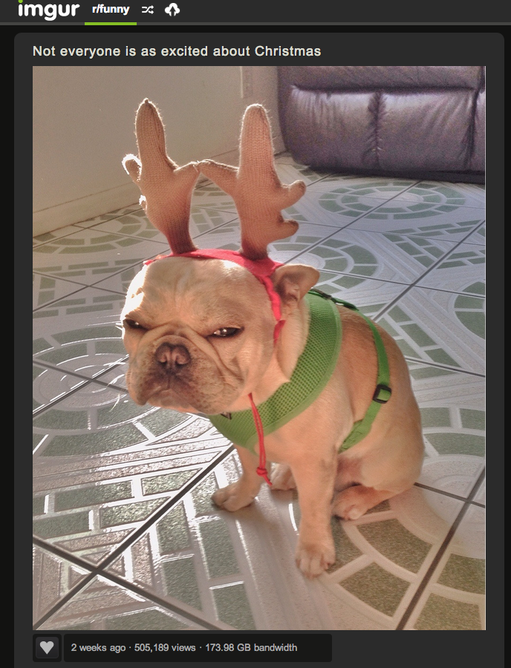


Computer networks are ubiquitous
Networks touch every part of our daily life
  Videoconferencing
  Web search
  Social networking
  Watching movies
  Ordering merchandise
  AI Chatbots
  Wasting time

Slide 10
Computer networks are ubiquitous
Networking is one of the most critical topics in CS
There would be no…
  GenAI
  Cloud
  Mobile apps, texting, …
  Streaming video
  Minecraft, Pokemon Go, Call of Duty, etc.
  Socials
  Big Data
  …

Slide 11
Goals
Fundamental understanding about computer networks
  All the way from bits on a wire…
  … across the ever-evolving Internet…
  … to a distributed applications
Focus on software and protocols
  Not hardware
  Minimal theory
Project-centric, hands-on experience
  Programming APIs
  Network Simulation
  Application-level protocols
  Distributed systems

Slide 12
My background
Before professoring
  BA in Physics and French -> CS textbook author -> PhD in CS (Networks/DS) -> postdoc
  Research focused car-to-car networks, P2P systems, crowdsourcing
Since joining Northeastern
  Focus on privacy, security, transparency, and mobile systems
  Topics include mobile/IoT privacy, PKIs, net neutrality, congestion control
Sabbatical
  Security architect at Akamai, focusing on Internet routing performance and security
Now
  Technology/policy, dark patterns, bias in AI, tracing personal data flows (beyond first hop)

Slide 13
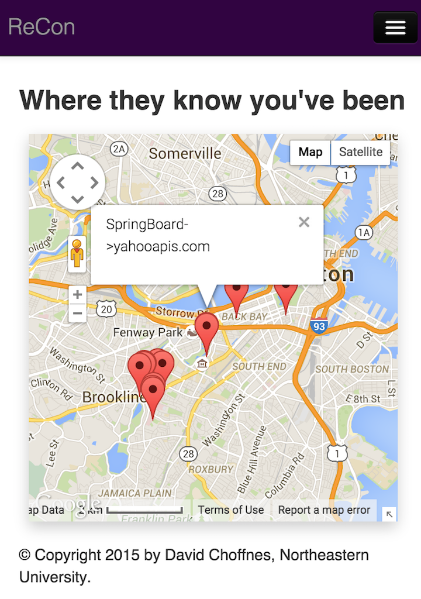
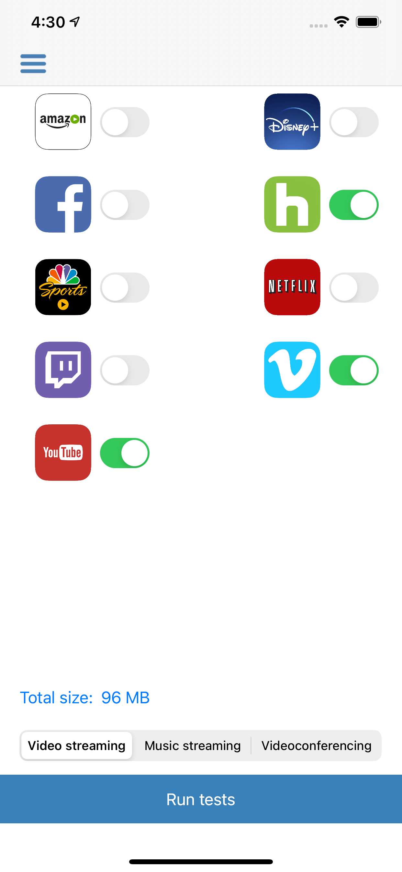
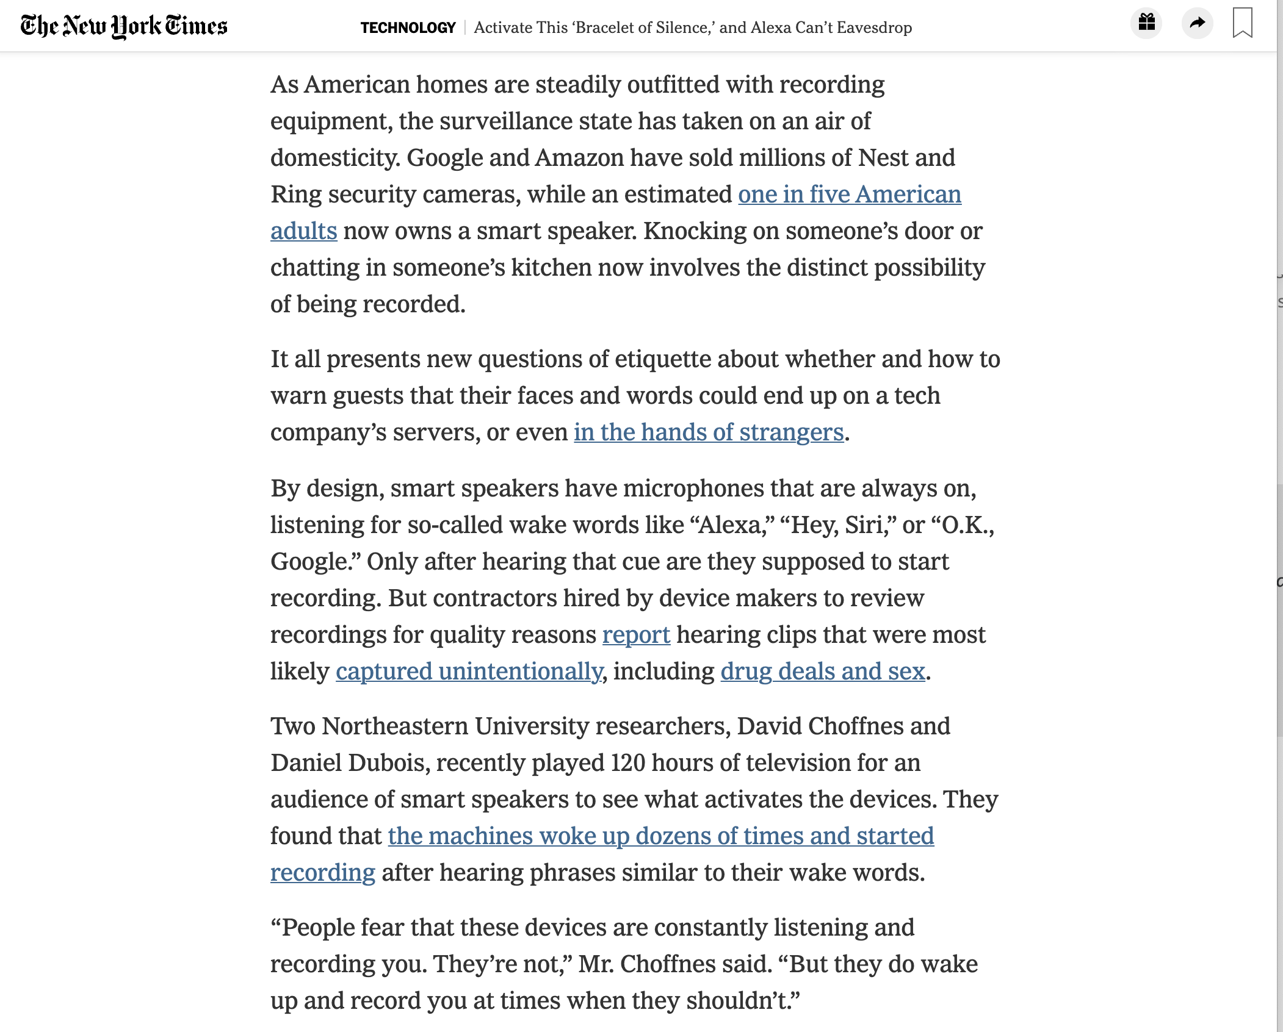
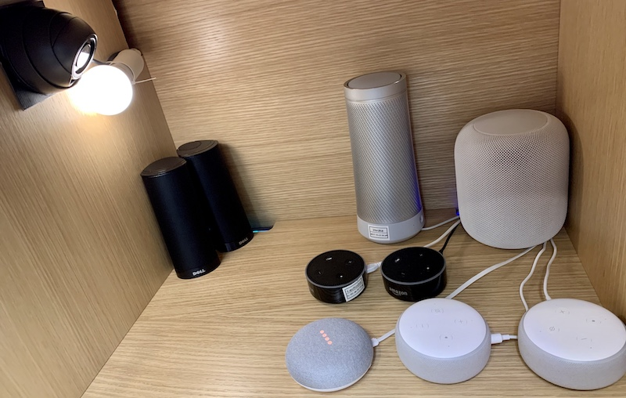
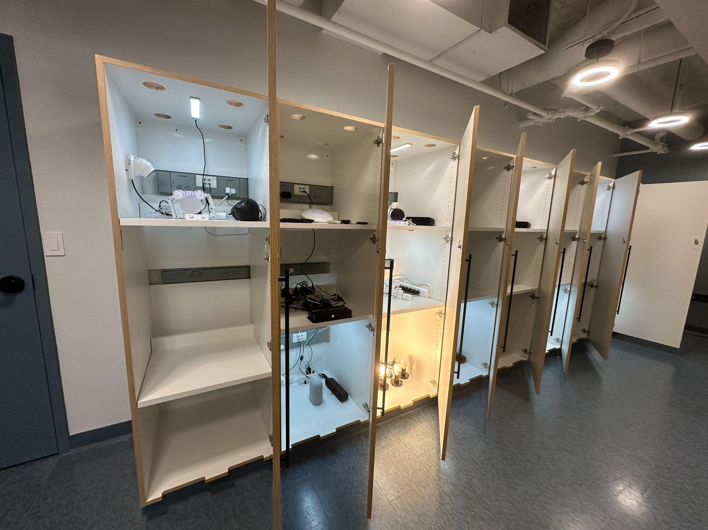
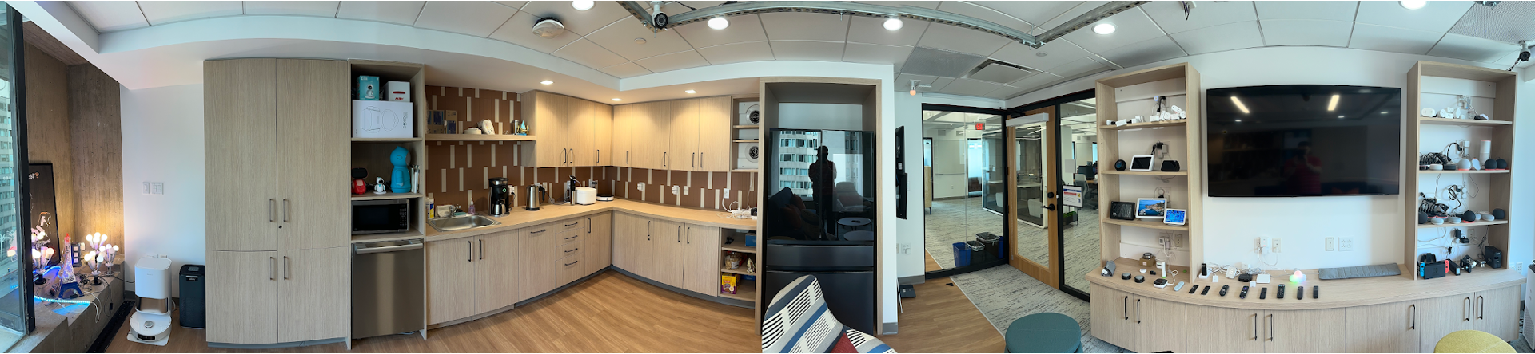
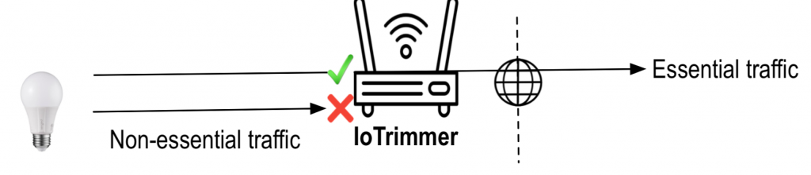
Example projects

Slide 14
Online Resources
Course website: https://4700.network/
Canvas embeds the course syllabus, has links to forum and assignments
Class forum is on Piazza
  Sign up today via Canvas
Homework and project submission will be via Gradescope
  Links available via Canvas
When in doubt, post to Piazza
  Piazza is HIGHLY preferable to email
    If you e-mail me a question, I will tell you to post it on Piazza
  Use folders (#homework1, #lecture_wk2, #project3, etc.)

Slide 15
Your TAs
TA(s)
  Christo Franklin, Sarah Gillespie, Elianne Mejia, Aditya Shenoy
  Office Hours:
  Will be held on Zoom (getting rooms on campus during business hours is impossible)
  Times/dates will be posted on 4700.network
  Zoom links will be available on Canvas

Slide 16
Class Like it’s 2019 Again
In person lectures
  That said, please wear a mask if you don’t feel well…
  Or stay home if you’re really ill
  Expectation is that vast majority of students will be in class

Slide 17
Teaching Style
I am a network researcher
  Things make sense to me that may not make sense to you
  I talk fast if nobody stops me
Solution: ask/answer questions!
  Seriously, ask questions (interrupting me is OK!)
  Seriously, answer questions!
  Staring at blank faces in class is very awkward
    I will continue doing so until someone answers my questions

Slide 18

Textbook
Optional textbook
  Computer Networks: A Systems Approach (Peterson and Davie, 5th Edition)
  6th Edition free online via library or author’s website: https://book.systemsapproach.org/index.html

Slide 19
Question: Who Has Taken CS 3700?
This course has significant overlap with CS 3700
Traditionally, it has been setup to try and mitigate this overlap somewhat
Is this still necessary?

Slide 20
Workload
 | Count | Points
Projects | 6 | 3%, 5%, 8%, 11%, 6%, 11%
Homeworks | 9 | 2% each
Weekly In-class Quizzes | 10 | 1% each
Midterm | 1 | 14%
Final | 1 | 14%
Total | -- | 100%

Slide 21
Projects
This course is project-centric
  Designed to give you real networking experience
  Start early!
  Seriously, start early!
6 projects
  Due at 11:59:59pm on Tuesday of specified week
  Use Gradescope to submit your code, documentation, etc.
  Working code is critical!

Slide 22
Project Logistics
You may choose the language for the projects
    Code must compile on the Gradescope docker instances (Ubuntu 22.04)
    Specs of the Gradescope container on Piazza
Project questions?
  Post them on Piazza!

Slide 23
Project Groups
Projects 3—6 will be completed in groups of one or two…
Partner selection
  Pick whoever you want (any section)
  You may switch partners between projects
  Do not complain to me about your lazy partner
    Hey, you picked them
Can’t find a partner?
  Post a message on Piazza!
  Getting the hint about Piazza?

Slide 24
Homeworks
Nine homeworks, due roughly weekly throughout the semester
Meant to reinforce and explore concepts from lectures

Slide 25
Late Policy
Each student is given 6 slip days they can use at any time to extend a deadline
  You don’t need to ask me, just turn-in stuff late
  All group members must have unused slip days
    i.e. if one member has zero slip days left, the whole group has zero slip days
Assignments are due at 11:59:59, no exceptions
  Slip days used in 1 day increments
  1 second late = 1 hour late = 1 day late
  No slip days left → 20% off per day

Slide 26
Quizzes
Ten in-class quizzes throughout the semester
Roughly weekly, except the Midterm week
Written, closed note
10 minutes will be offered at the beginning of class, but it won’t all be needed
Meant to assess understanding of lecture materials, encourage attendance, and fight the scourge of AI apathy
Also really good practice for exams, speaking of which…

Slide 27
Exams
Midterm and Final
  Administered in person
  Midterm will be in-class, Final will be during finals week
  The Final will be cumulative
Guessing is strongly discouraged
  You get 20% of points for leaving a question blank
  0% if you have both a right answer and a wrong answer
Students may bring one 8.5x11 sheet of notes to the exams

Slide 28
Exams
There are none
Nothing to see here

Slide 29
Final Grades
At the end of the semester, all of your grades will sum to 100 points
  3+5+8+11+6+11+2*9+1*10+14*2 = 100
Final grades are based on a simple scale:
  A >92, A- 90-92, B+ 87-89, B 83-86, B- 80-82, …
We don’t curve grades
All final grades will be rounded up to the next integer
  Example: 89.00000000000000001 → 90 which is an A-

Slide 30
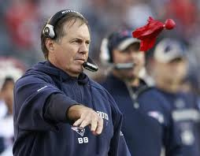
Regrade Requests
Use Gradescope to request regrades
  Specify the problem(s) you want regraded
  For each problem, explain why the grade is in error
  The grader will review the request and respond
If not satisfied with result, each student gets two challenges with me
  Modeled after NFL system
  If you challenge a regrade and you are wrong, you lose a challenge
  When you are out of challenges, you cannot ask for regrading
Don’t sweat the small stuff
  Challenging minor errors does not make me a happy Professor
  If the change is <5% of the grade, don’t bother
Full details on the website/syllabus

Slide 31
AI Policy
Use of AI is forbidden in this class
  No chatbots, no AI agents, no AI coding assistants, etc.
You must complete projects and homeworks without AI assistance
Why?
  Historically, AIs routinely get our questions wrong and fail at our assignments
  The latest educational research is clear: AI use ruins learning

Slide 32
Cheating
Do not do it
  Seriously, don’t make me say it again
Cheating is an automatic negative grade
  Example: cheating on a project worth 5% will net you -5% for the course
  Cheating is worse than doing nothing and getting 0%
  I will send any and all suspects to OSCCR without exception
Project code and homeworks must be original
  You (and your groupmates) only for projects
    Unless we give you starter code, obviously
  StackOverflow/Quora are not your friends
  Copying from public Githubs is cheating
  Turning in code generated by an LLM, e.g., CoPilot, is cheating
  If you have questions about an online resource, ask

Slide 33

What questions do you have?

Slide 34
One last note
Please take care of yourselves and each other
  Seek help if you need it (UHCS, WeCare, etc)
  My (virtual) door is always open

