Slide 1
CS 4700
Network Fundamentals
NAT
(You Better Forward Those Ports)
Revised 10/12/23

Slide 2
The IPv4 Shortage
Problem: consumer ISPs typically only give one IP address per-household
  Additional IPs cost extra
  More IPs may not be available
Today’s households have more networked devices than ever
  Laptops and desktops
  TV, bluray players, game consoles
  Tablets, smartphones, eReaders
How to get all these devices online?

Slide 3
Private IP Networks
Idea: create a range of private IPs that are separate from the rest of the network
  Use the private IPs for internal routing
  Use a special router to bridge the LAN and the WAN
Properties of private IPs
  Not globally unique
  Usually taken from non-routable IP ranges (why?)
Typical private IP ranges
  10.0.0.0 – 10.255.255.255
  172.16.0.0 – 172.31.255.255
  192.168.0.0 – 192.168.255.255

Slide 4

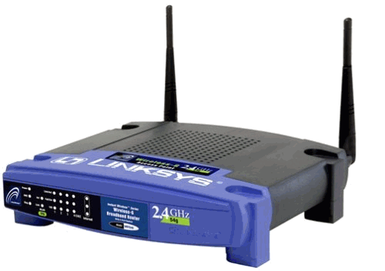
Private Networks
Private
Network
192.168.0.1
192.168.0.1
Private
Network
192.168.0.2
192.168.0.2
Internet
NAT
NAT
71.2.33.56
192.168.0.0
192.168.0.0
66.31.210.69

Slide 5
Network Address Translation (NAT)
NAT allows hosts on a private network to communicate with the Internet
  Warning: connectivity is not seamless
Special router at the boundary of a private network
  Replaces internal IPs with external IP by modifying packet headers
    This is “Network Address Translation”
  May also replace TCP/UDP port numbers
Maintains a table of active flows
  Outgoing packets initialize a table entry
  Incoming packets are rewritten based on the table

Slide 6
Basic NAT Operation
Private Network
Internet
Source: 192.168.0.1:2345
Dest: 74.125.228.67:80
Source: 66.31.210.69:2345
Dest: 74.125.228.67:80
Private Address | Public Address
192.168.0.1:2345 | 74.125.228.67:80
192.168.0.1
66.31.210.69
74.125.228.67
Source: 74.125.228.67:80
Dest: 192.168.0.1:2345
Source: 74.125.228.67:80
Dest: 66.31.210.69:2345

Slide 7
Advantages of NATs
Allow multiple hosts to share a single public IP
Allow migration between ISPs
  Even if the public IP address changes, you don’t need to reconfigure the machines on the LAN
Load balancing
  Forward traffic from a single public IP to multiple private hosts

Slide 8


Natural Firewall
Private Network
Internet
Private Address | Public Address
192.168.0.1
66.31.210.69
74.125.228.67
Source: 74.125.228.67
Dest: 66.31.210.69
Source: 74.125.228.67
Dest: 192.168.0.1

Slide 9
Concerns About NAT
Performance/scalability issues
  Per flow state!
  Modifying IP and Port numbers means NAT must recompute IP and TCP checksums
Breaks the layered network abstraction
Breaks end-to-end Internet connectivity
  192.168.*.* addresses are private
  Cannot be routed to on the Internet
  Problem is worse when both hosts are behind NATs
What about IP addresses embedded in data payloads?

Slide 10

Port Forwarding
Private Network
Internet
Private Address | Public Address
192.168.0.1:7000 | *.*.*.*:*
192.168.0.1
66.31.210.69
74.125.228.67
Source: 74.125.228.67:8679
Dest: 192.168.0.1:7000
Source: 74.125.228.67:8679
Dest: 66.31.210.69:7000

Slide 11

Hole Punching
Problem: How to enable connectivity through NATs?
NAT 1
NAT 2
192.168.0.2
192.168.0.1
66.31.210.69
59.1.72.13
Two application-level protocols for hole punching
  STUN (RFC 5389) and TURN (RFC 5766)
  ICE (RFC 8445) combines signaling for STUN & TURN

Slide 12

STUN
Session Traversal Utilities for NAT
  Use a third-party to echo your global IP address
  Also used to probe for symmetric NATs/firewalls
    i.e. are external ports open or closed?
What is my global IP address?
Please echo my IP address
Your IP is 66.31.210.69
192.168.0.1
STUN Server
66.31.210.69

Slide 13
Problems With STUN
Only useful in certain situations
  One peer is behind a symmetric NAT
  Both peers are behind partial NATs
Not useful when both peers are fully behind full NATs
NAT 1
NAT 2
192.168.0.2
192.168.0.1
66.31.210.69
59.1.72.13

Slide 14
TURN
Traversal Using Relays around NAT
NAT 1
NAT 2
192.168.0.2
192.168.0.1
Please connect to me on 66.31.210.69:7000
192.168.0.1:7000
192.168.0.2:7000
66.31.210.69
59.1.72.13
TURN Server

